Slide 1
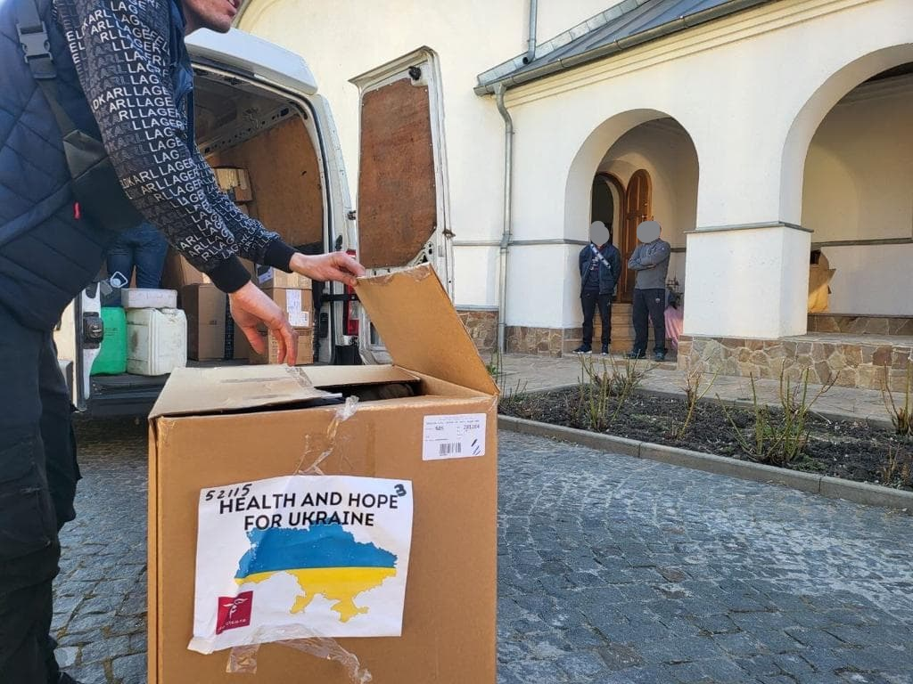

Project C.U.R.E.: War Response to the Medical and Humanitarian Needs in Ukraine

Slide 2

Who is Project C.U.R.E.?
Project C.U.R.E. is the world’s largest distributor of donated medical equipment and supplies to resource limited communities across the globe, touching the lives of patients, families, and children in more than 135 countries.

Slide 3
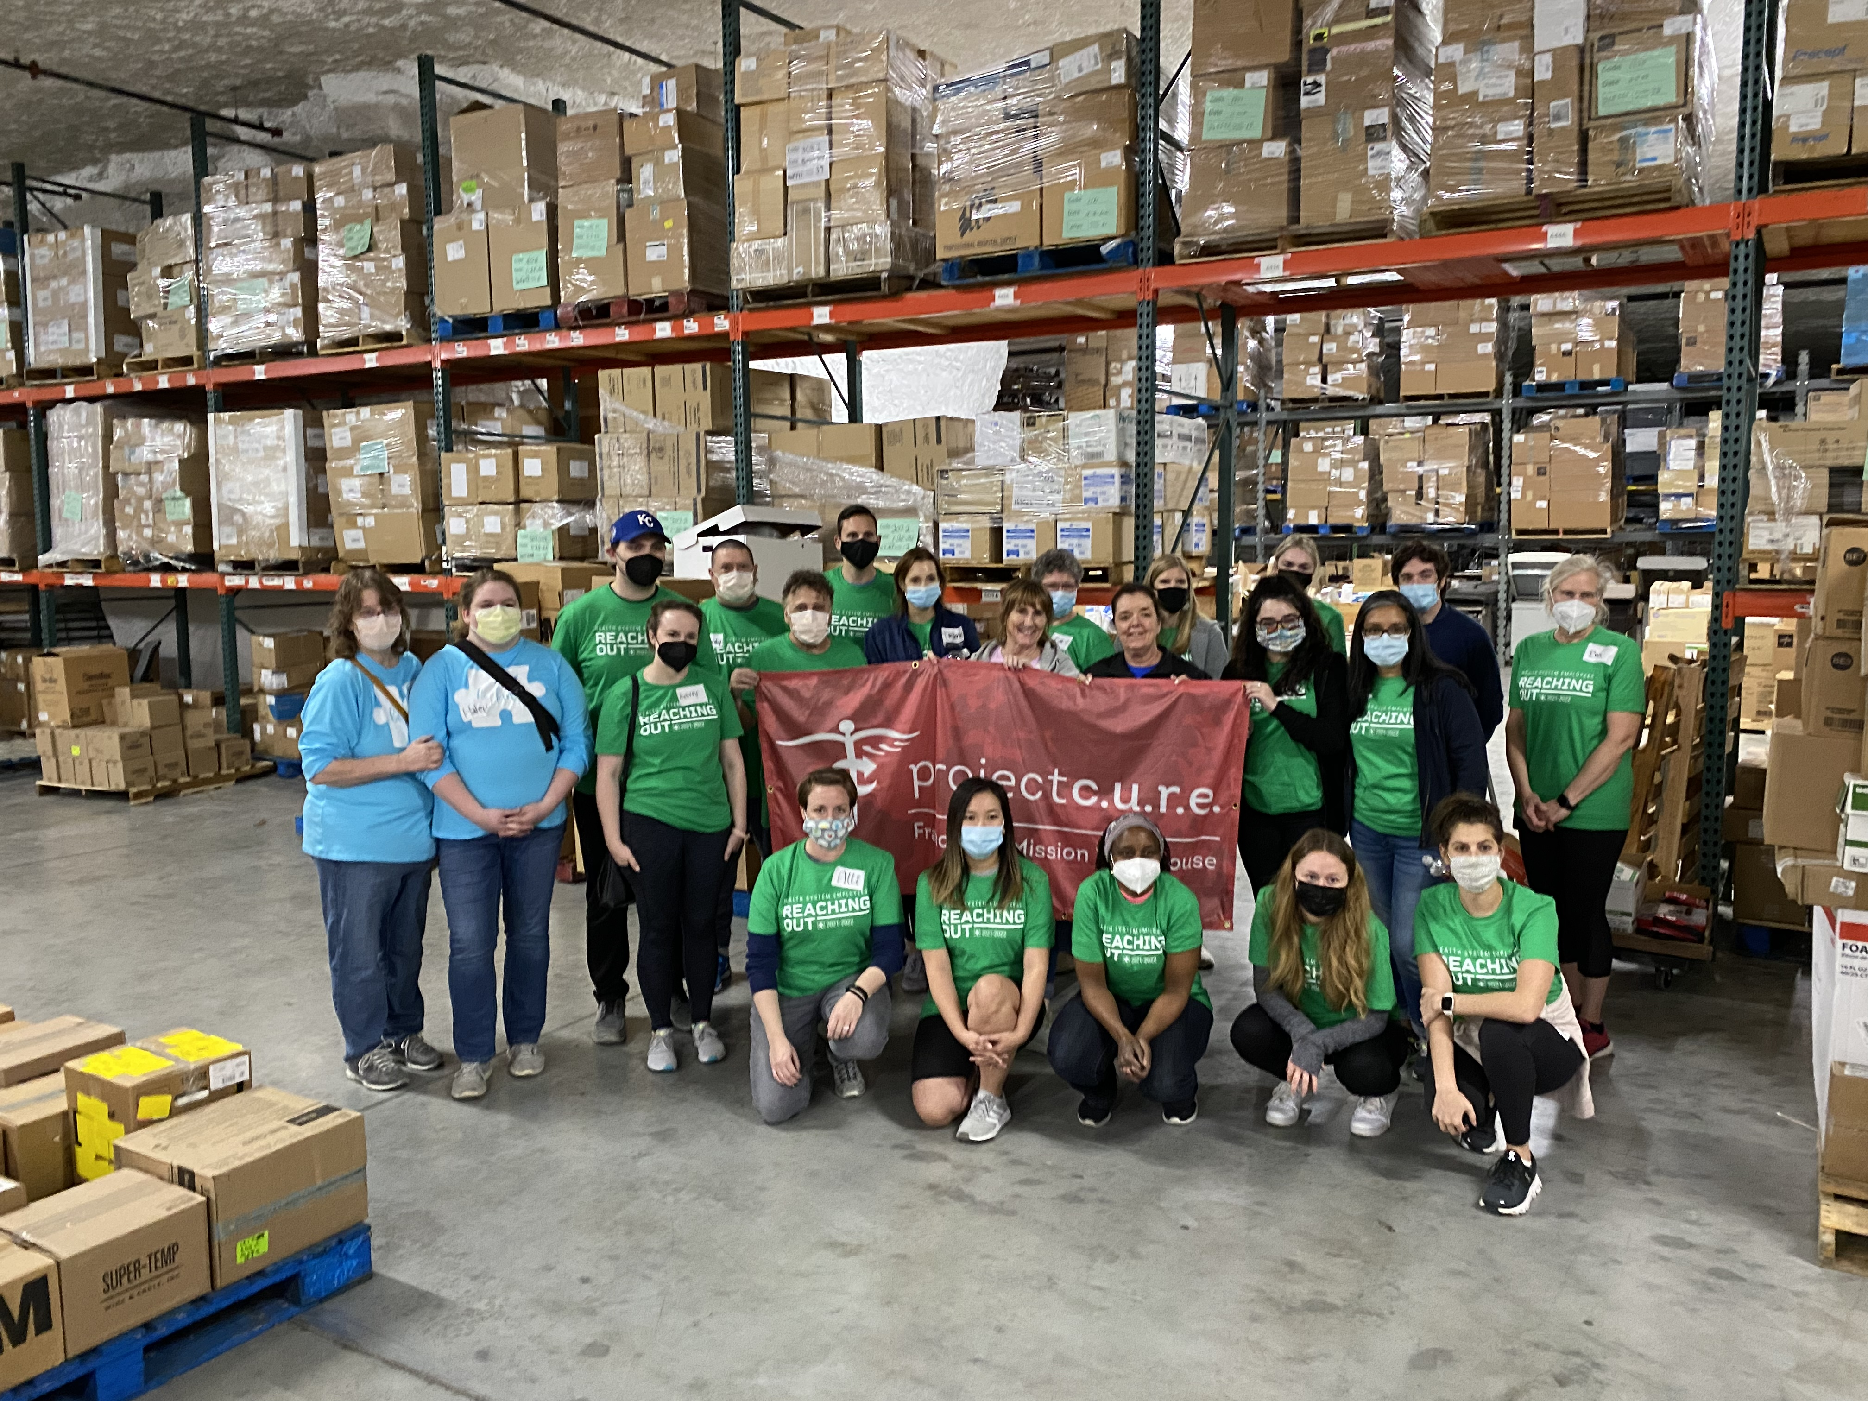
Project C.U.R.E.
Work in 135 Countries
June 1, 2022 – May 31, 2023: 226 shipments to 45 countries, $66MM GIK
35 full time staff
15,000 volunteers this past year in our warehouses

Slide 4
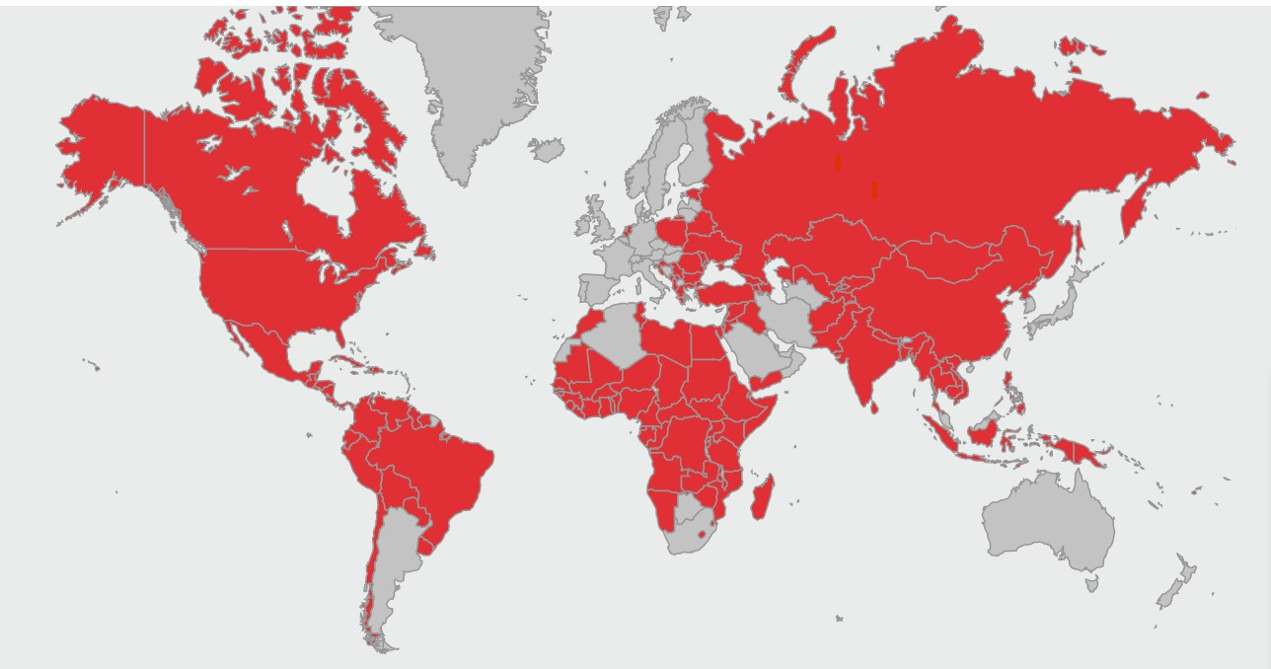
Global Impact
Since inception, Project C.U.R.E. has delivered 2,401 cargo containers of medical relief to desperately needly people in more than 135 countries.

Slide 5
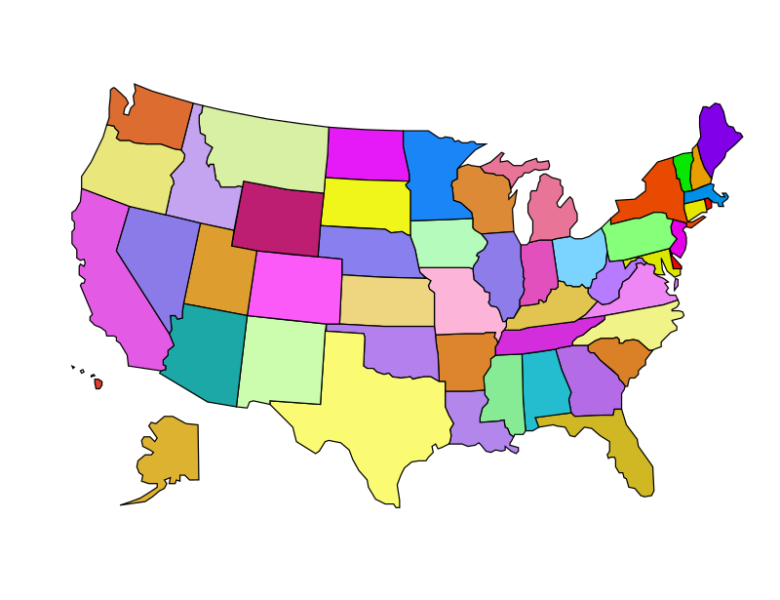



Project C.U.R.E.’s 7 Distribution Centers
Chicago, IL
Philadelphia, PA
International HQ
Denver, CO
Kansas City, MO
Nashville, TN
Phoenix, AZ
Houston, TX

Slide 6
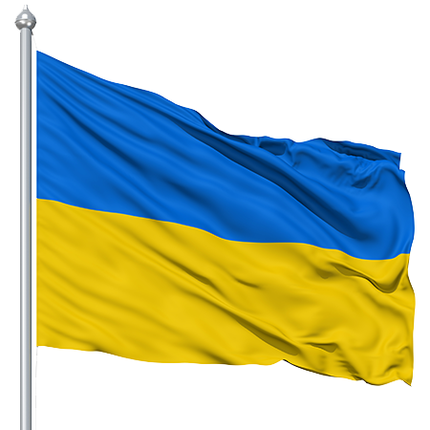
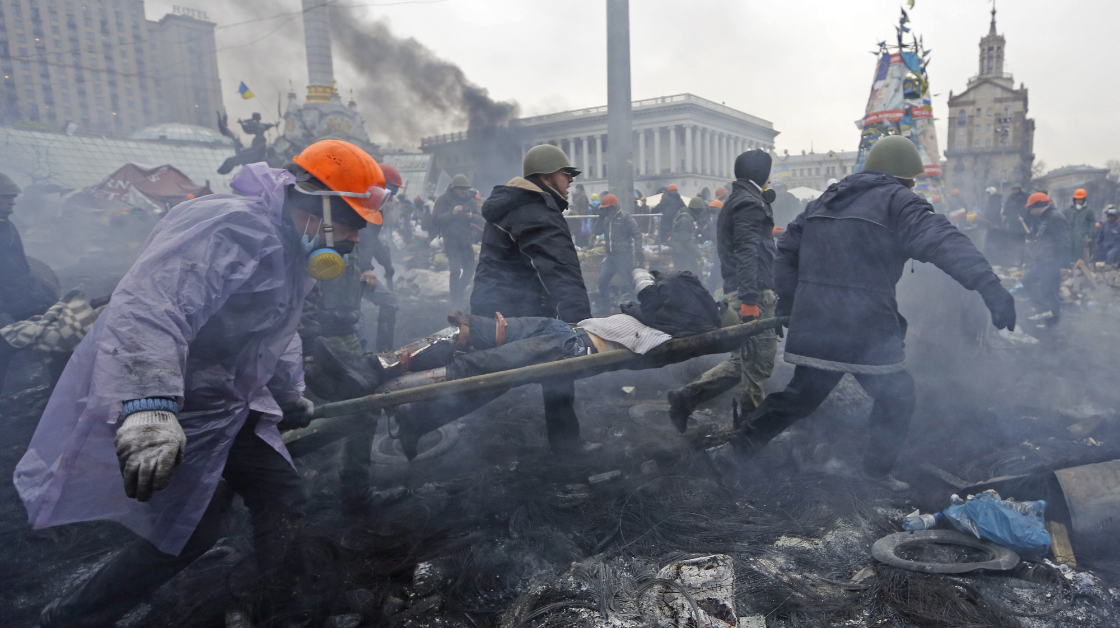
Ukraine

Slide 7
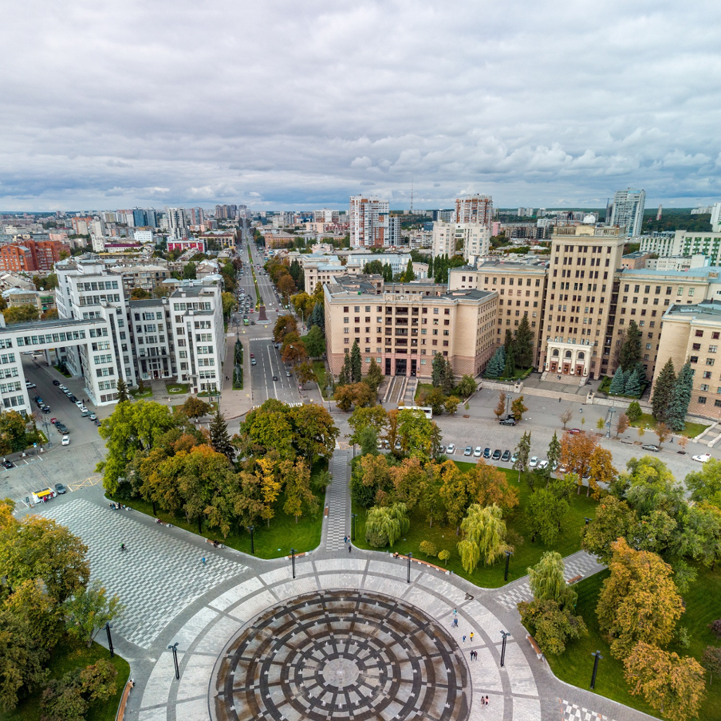
Project C.U.R.E. in Ukraine
Project C.U.R.E. worked in Ukraine 10 years prior to the Russian invasion
From 2000-2022, Project C.U.R.E. sent 53 cargo shipments to Ukraine
National Health Council of Ukraine’s project “Support Hospitals in Ukraine”

Slide 8
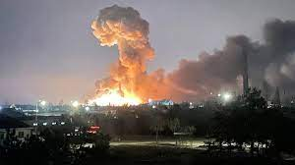
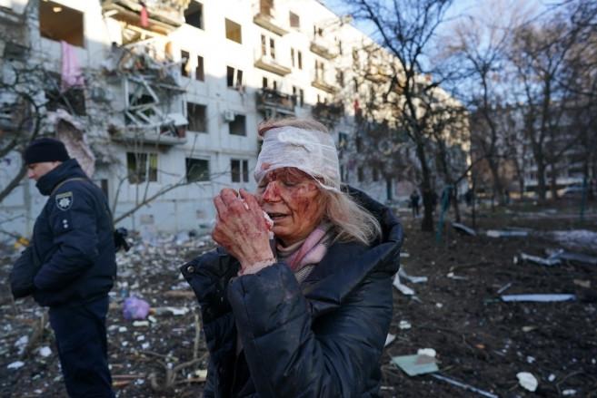
February 24, 2022 – the world changed.

Slide 9
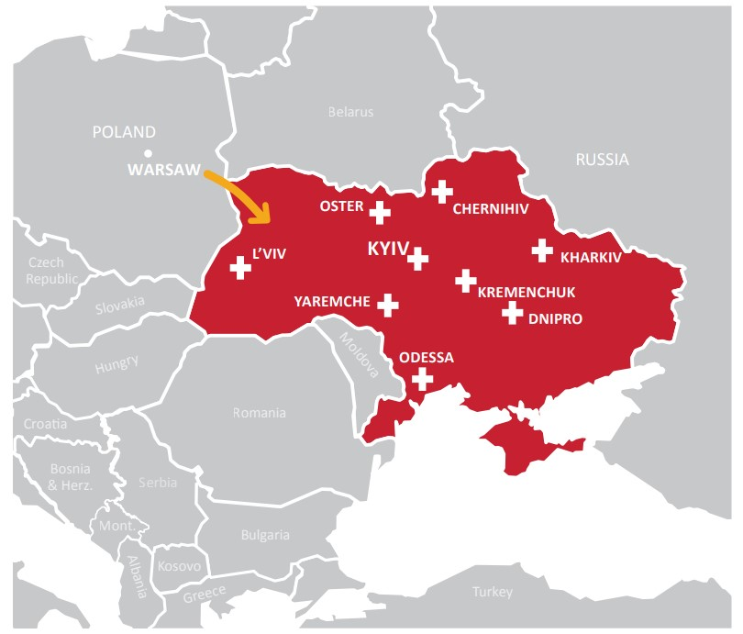
Project C.U.R.E. in Ukraine
Project C.U.R.E. Response
Immediate response: support our current partners on the ground
  Inventory of trauma and disaster relief items
  Work with organizations for donated air freight
  Identify means of in country delivery
Inundated with new requests from people and organizations around the world

Slide 10
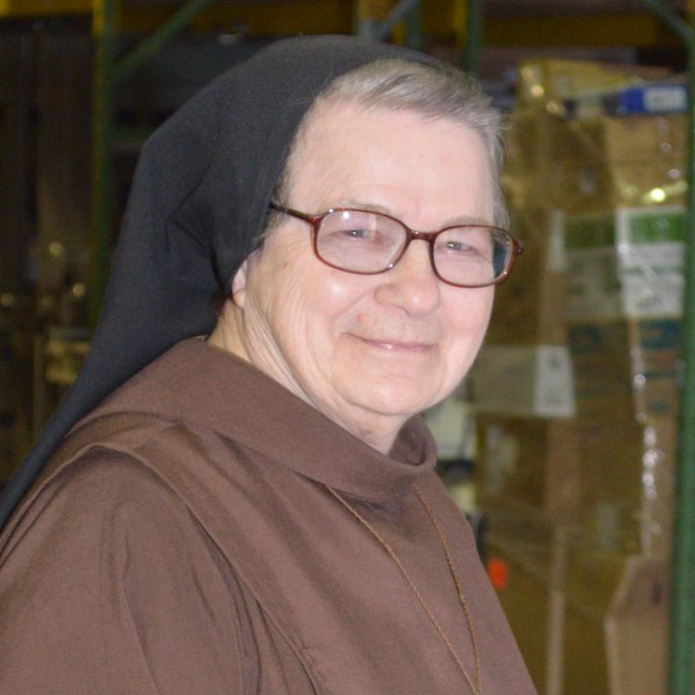
Project C.U.R.E. & the Marians
1985 – 2020: Franciscan Mission Warehouse (FMW)
Dr. Bryan Thatcher and Sister Andrea Kantner shipped containers all over the world
2020: FMW affiliation with
Project C.U.R.E.
2022: Dr. Thatcher reached out to Sister Andrea about shipments to Ukraine

Slide 11
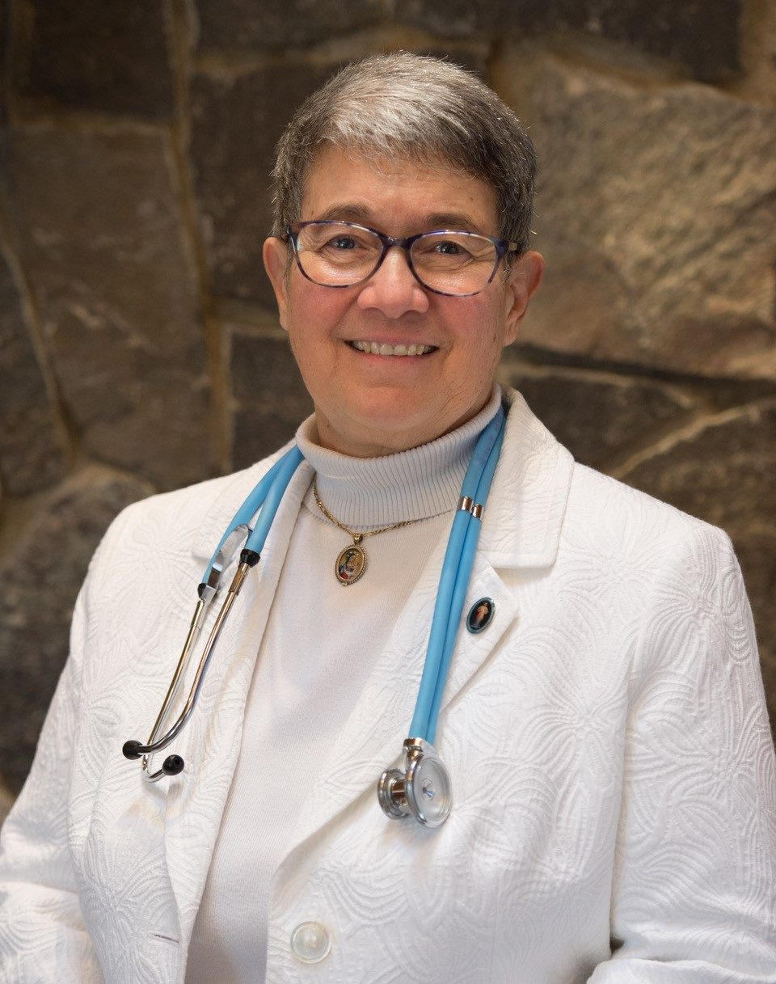
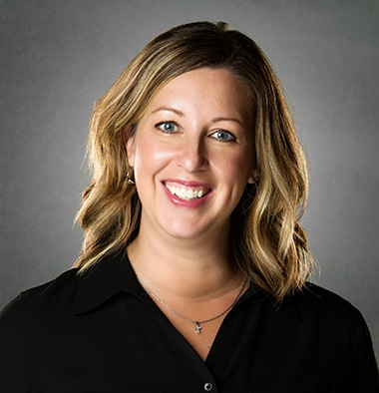
Team Project C.U.R.E./Marian Helpers
Marie Romagnano, MSN, RN, CCM-R
Healthcare Professionals for Divine Mercy
Kristin Robinson
Executive Director
Project C.U.R.E. Kansas City

Slide 12
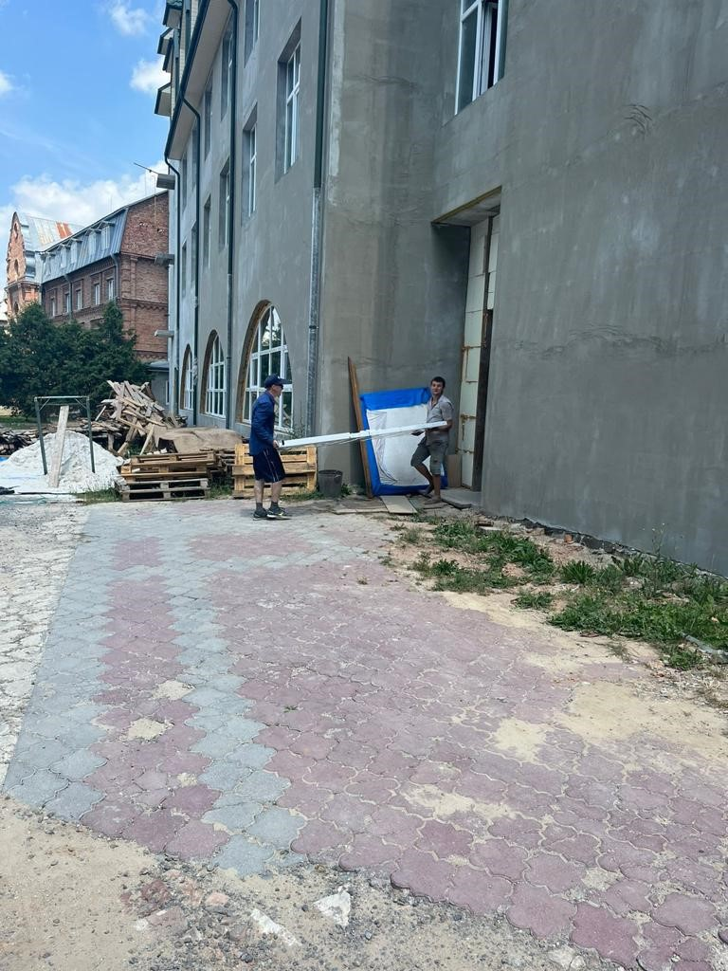
Early Days of the War
Fr. Lukasz – Warsaw
Delivery drivers across the border
Airfreight
Mercy House - Gorodok
People fleeing from danger to other areas of the country – created refugee issue in Gorodok

Slide 13
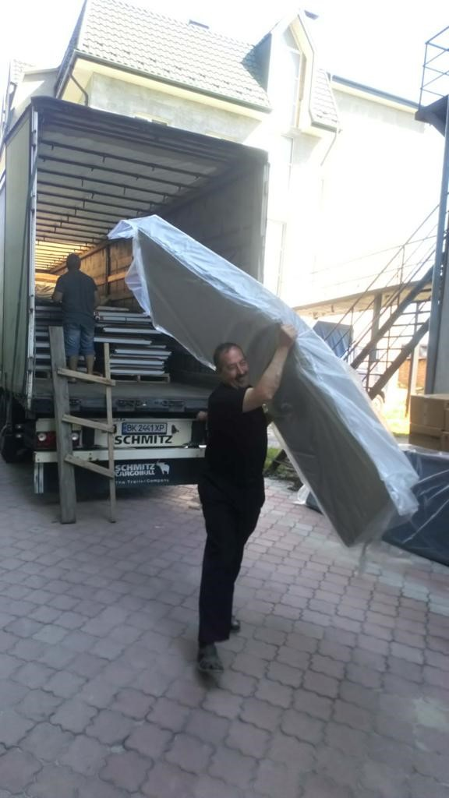
Mercy House
Bed shipment:
Enabled Mercy House to take in refugees fleeing from other parts of Ukraine

Slide 14
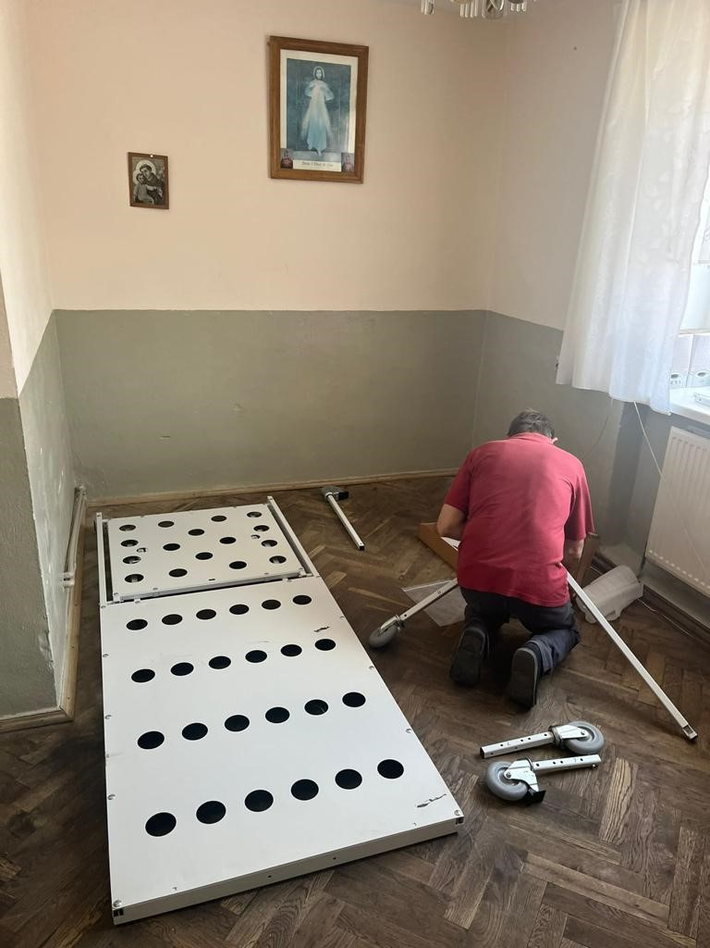
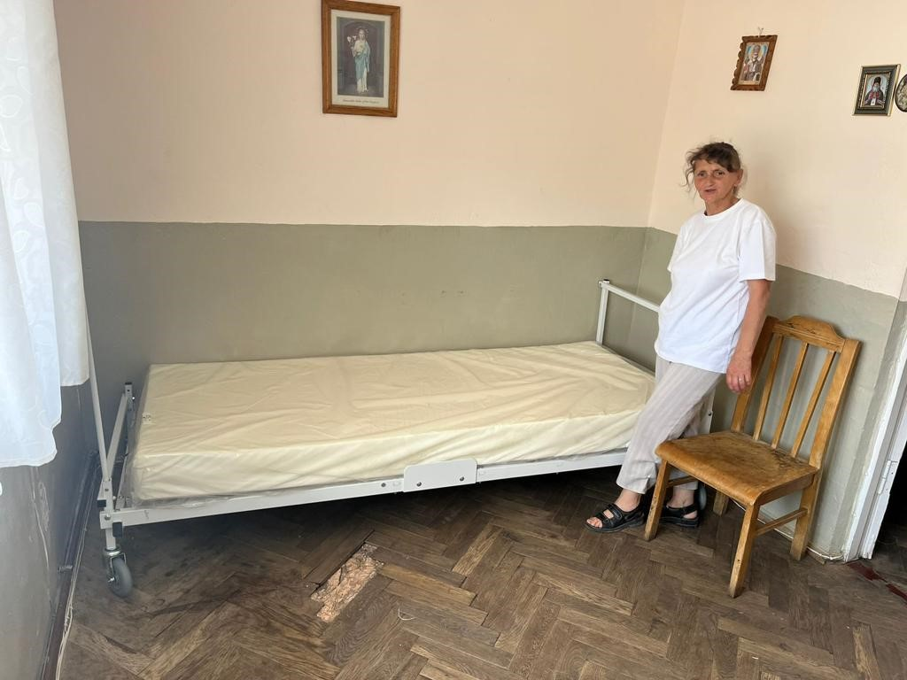
Mercy House

Slide 15
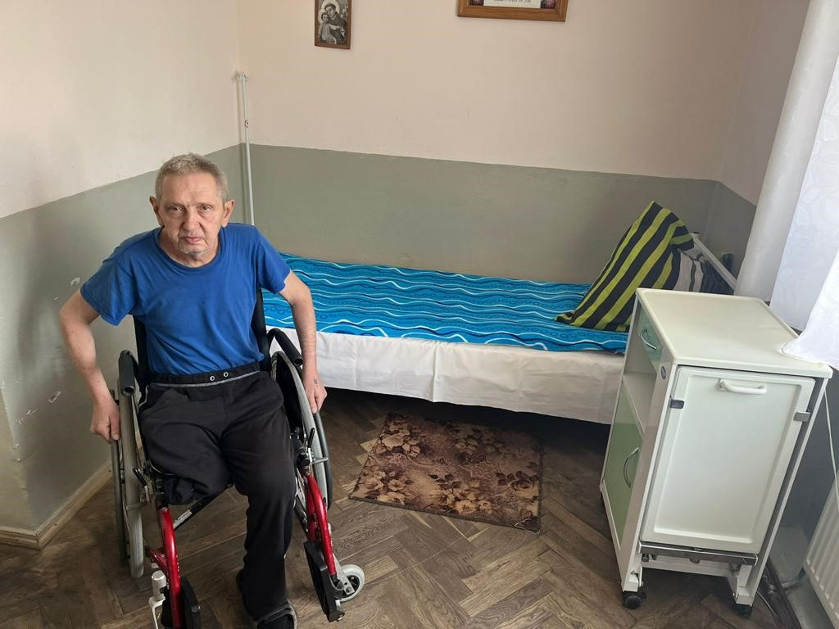
Mercy House

Slide 16
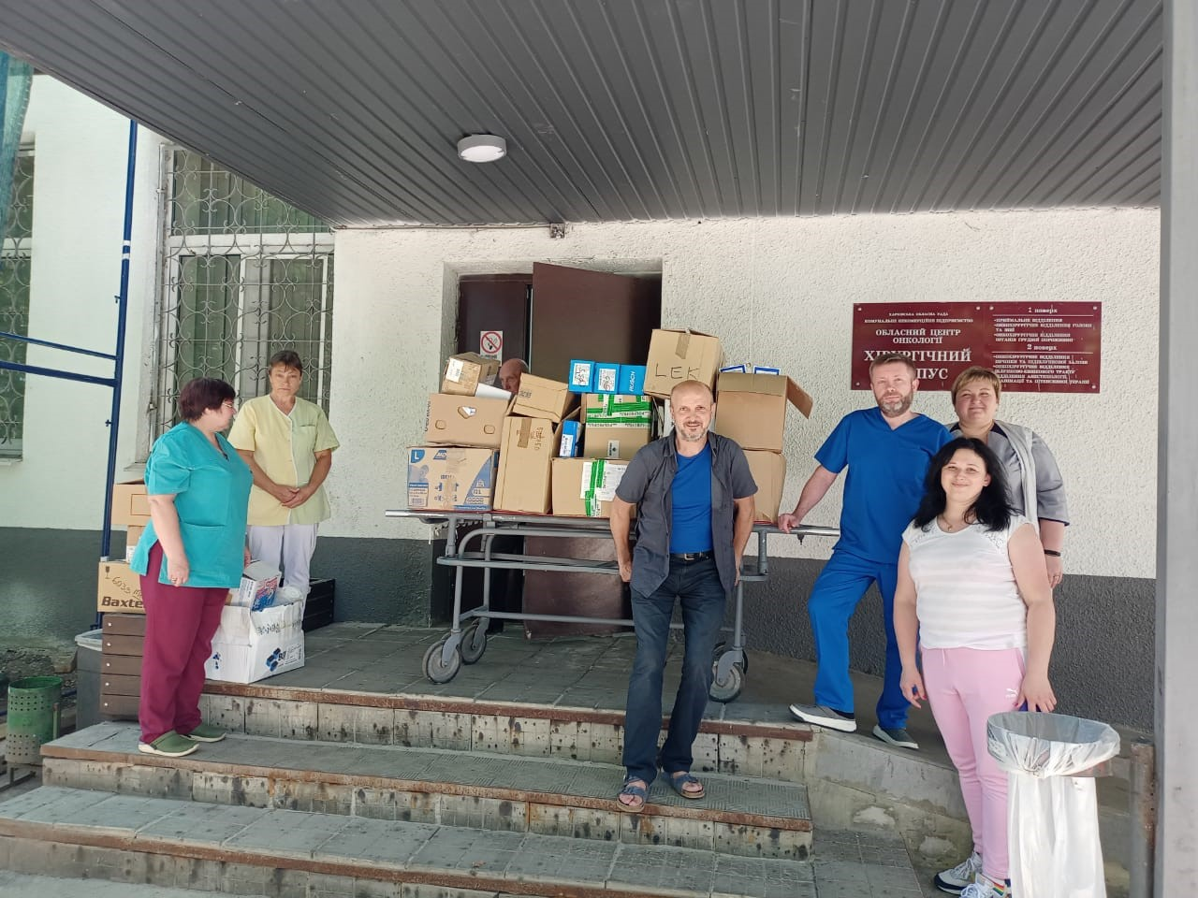
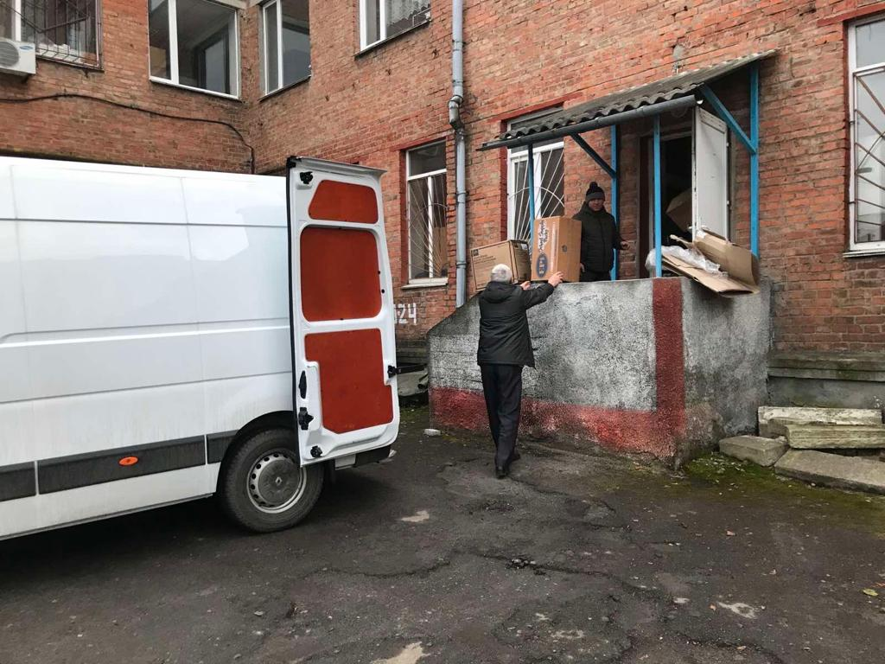
Delivery direct to Ukraine
No longer need to go through
Poland
Working with Fr. Paul and
his team of volunteers
Connections to hospitals

Slide 17

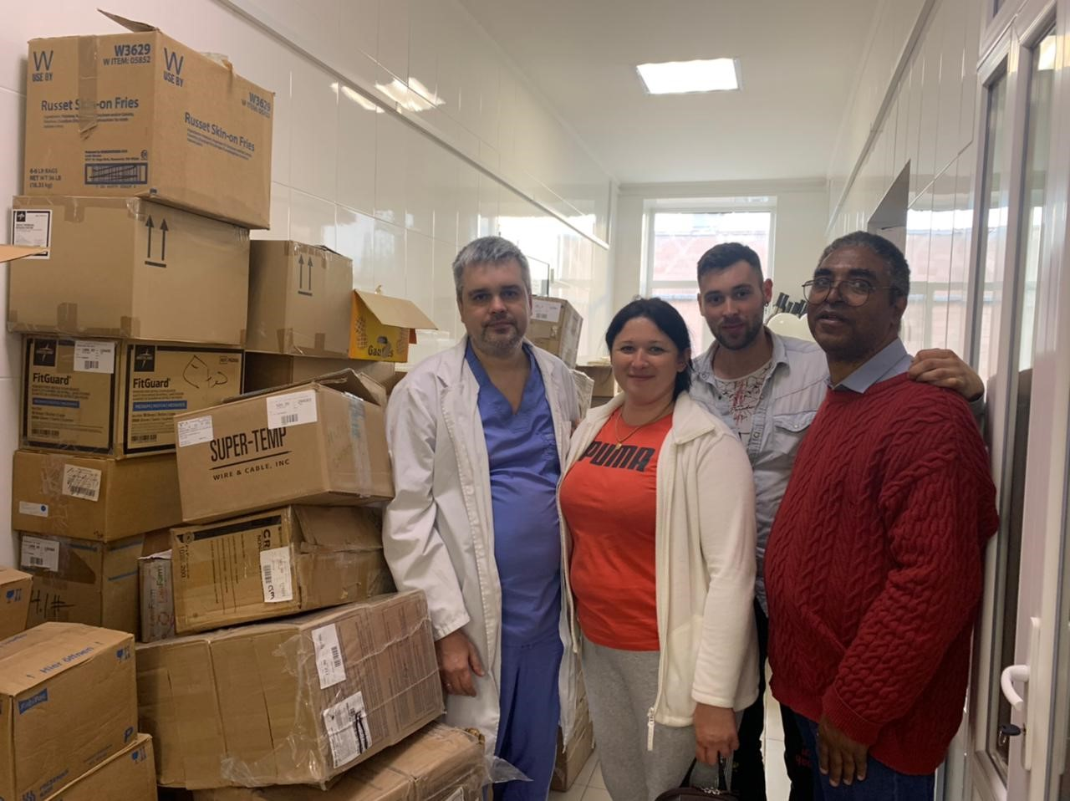
Kharkiv

Slide 18
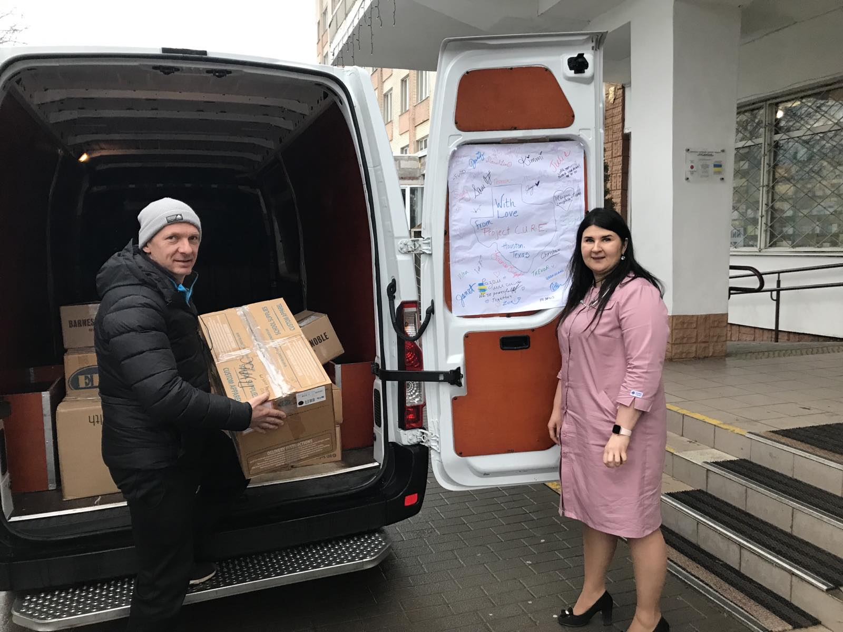
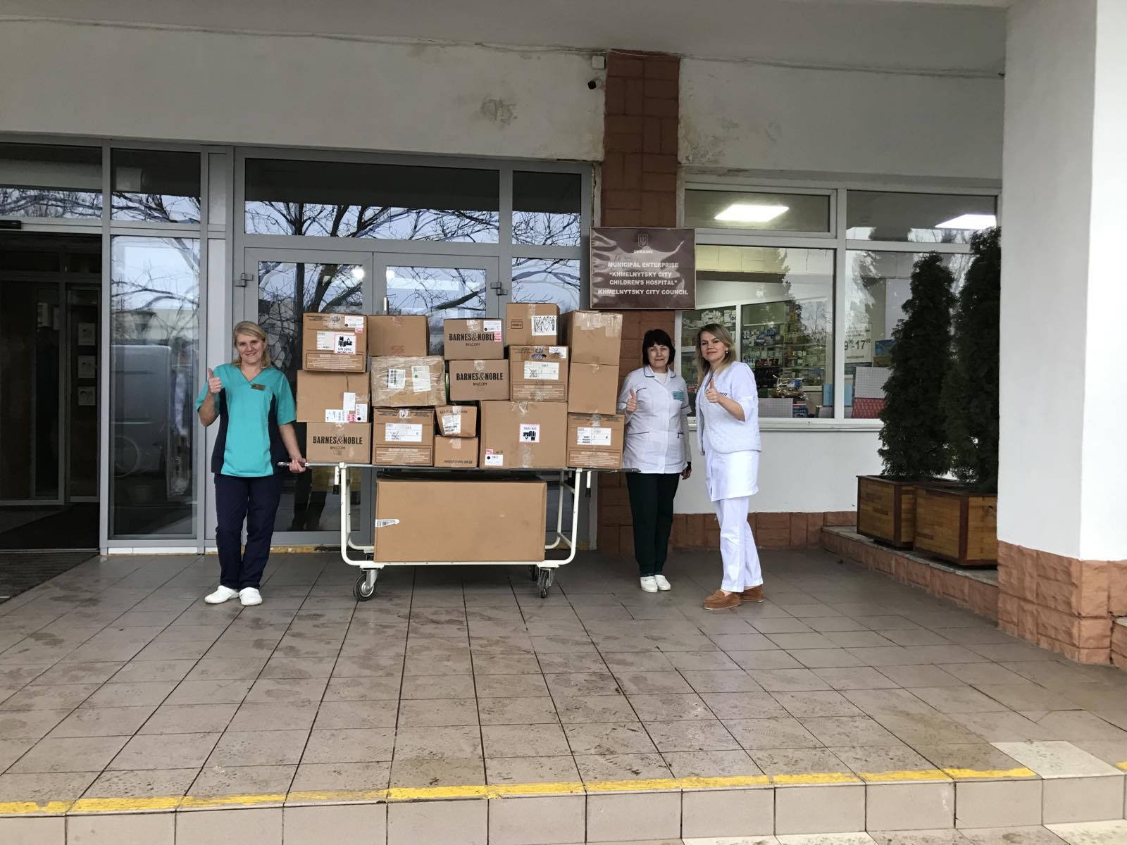
Khmelnisky

Slide 19
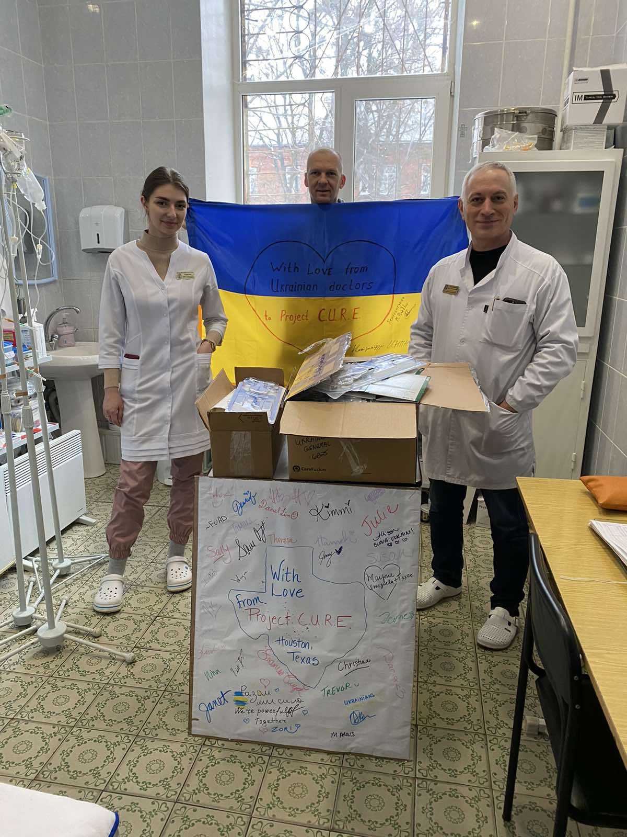
Shipments to Date to Marians
19 shipments – airfreight and ocean-going cargo container
GIK value of all shipments: $3.7mm
Medical supplies, equipment, trauma supplies, LuminAID lanterns, clothing
Cargo container 5, 6, and 7 in process

Slide 20
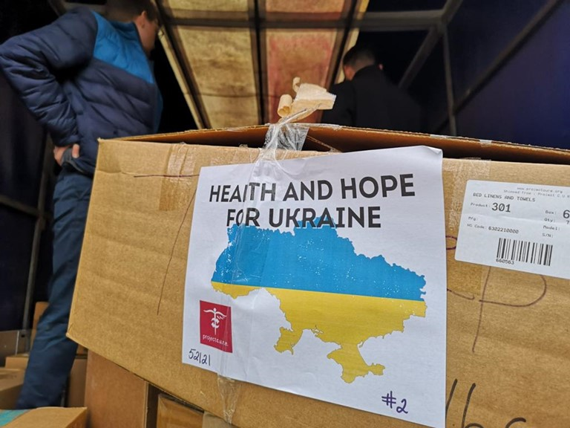
Support for the Long Haul
Estimates of 42,000 civilians wounded to date
180,000 Ukrainian military wounded
Total shipments to Ukraine from Project C.U.R.E. since invasion: 83
Ukraine received the largest number of shipments this fiscal year
Will continue through the end of the war and in rebuilding of the country

Slide 21
Let’s Connect!
Kristin Robinson
913-568-8043
kristinrobinson@projectcure.org
ProjectCURE.org

Slide 22



Ukraine War and the Medical and Humanitarian Challenge:
Catastrophic Medical Case Management with Project C.U.R.E.
Marie Romagnano, MSN, RN, CCM-R
Founder of Healthcare Professionals
for Divine Mercy,
Assistant Clinical Professor, School of Nursing,
College of Our Lady of the Elms
Director, Medical and Humanitarian Case Management Operations
for Ukraine Relief

Slide 23
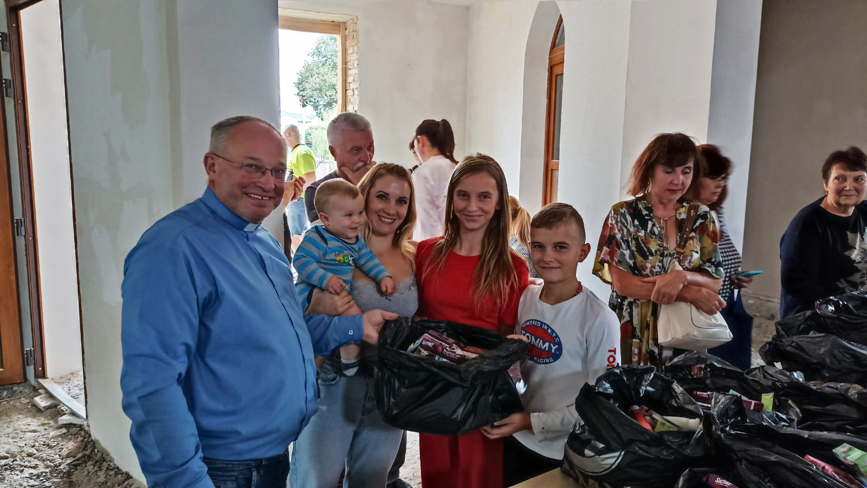
Marian Fathers in Ukraine
17 Parishes in Ukraine
Assisted for the last 20 years by
Dr. Bryan Thatcher, Founder of the
Eucharistic Apostles of Divine Mercy
Shipped Containers to Ukraine and around the world with Franciscan Sister Andrea Kantner, founder of the Mission Warehouse
2019 – Sr. Andrea partnered with Project C.U.R.E. and the Kansas City warehouse was named Project C.U.R.E. Franciscan Mission Warehouse and grew to over 50,000 sq. ft.

Slide 24
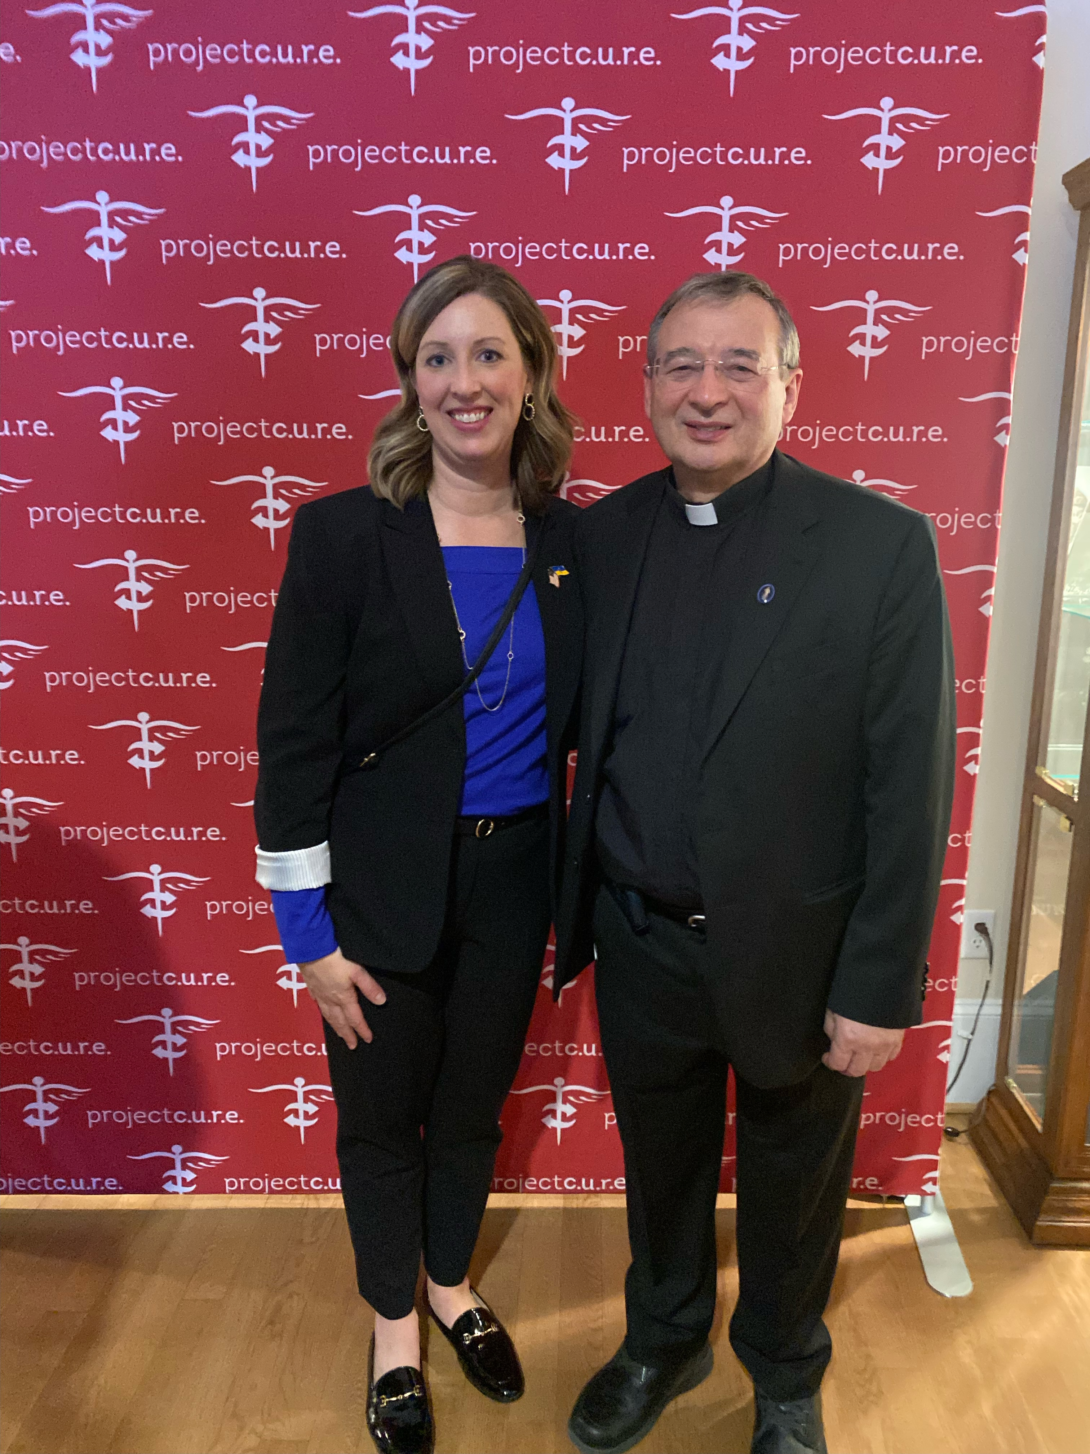
Project CURE Team and Marians
Kristin Robinson
Executive Director - Kansas City
Ukranian Embassy with Kristin Robinson
Fr. Kazimierz Chwalek, MIC

Slide 25
Marian Ministries Founders in Action
Bryan Thatcher, MD
Eucharistic Apostles of Divine Mercy
Marie Romagnano, MSN, RN, CCM-R
Healthcare Professionals for Divine Mercy

Slide 26
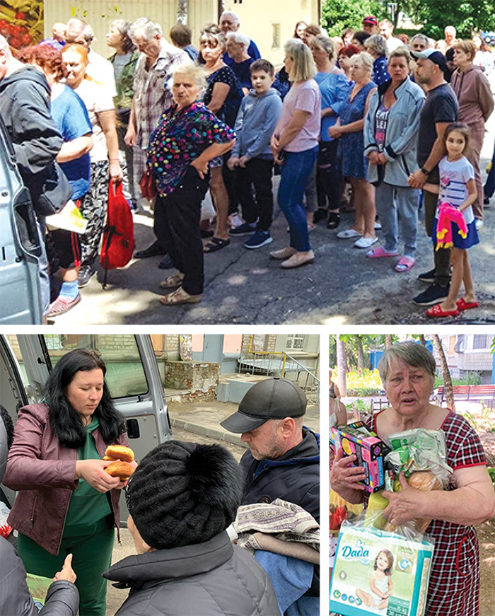
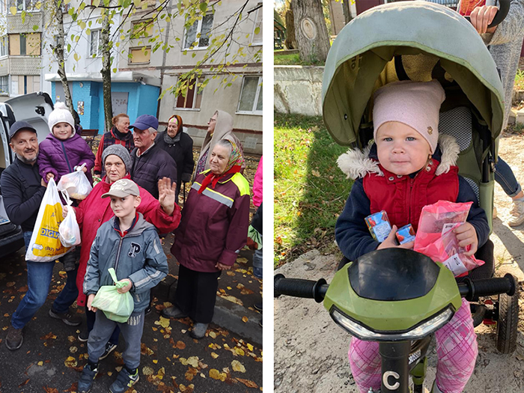
Immediate Humanitarian Aid by Marian Fathers and Project C.U.R.E.

Slide 27
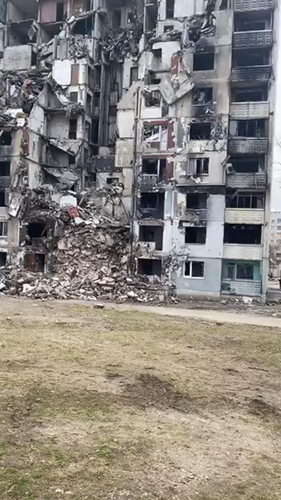
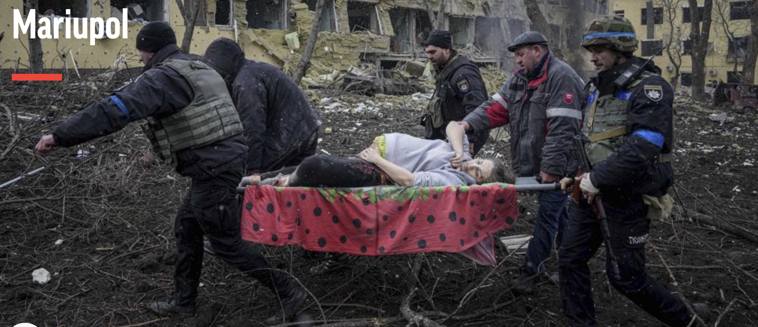
Residential Buildings, Hospitals and Schools Impacted By Missiles AP photos

Slide 28
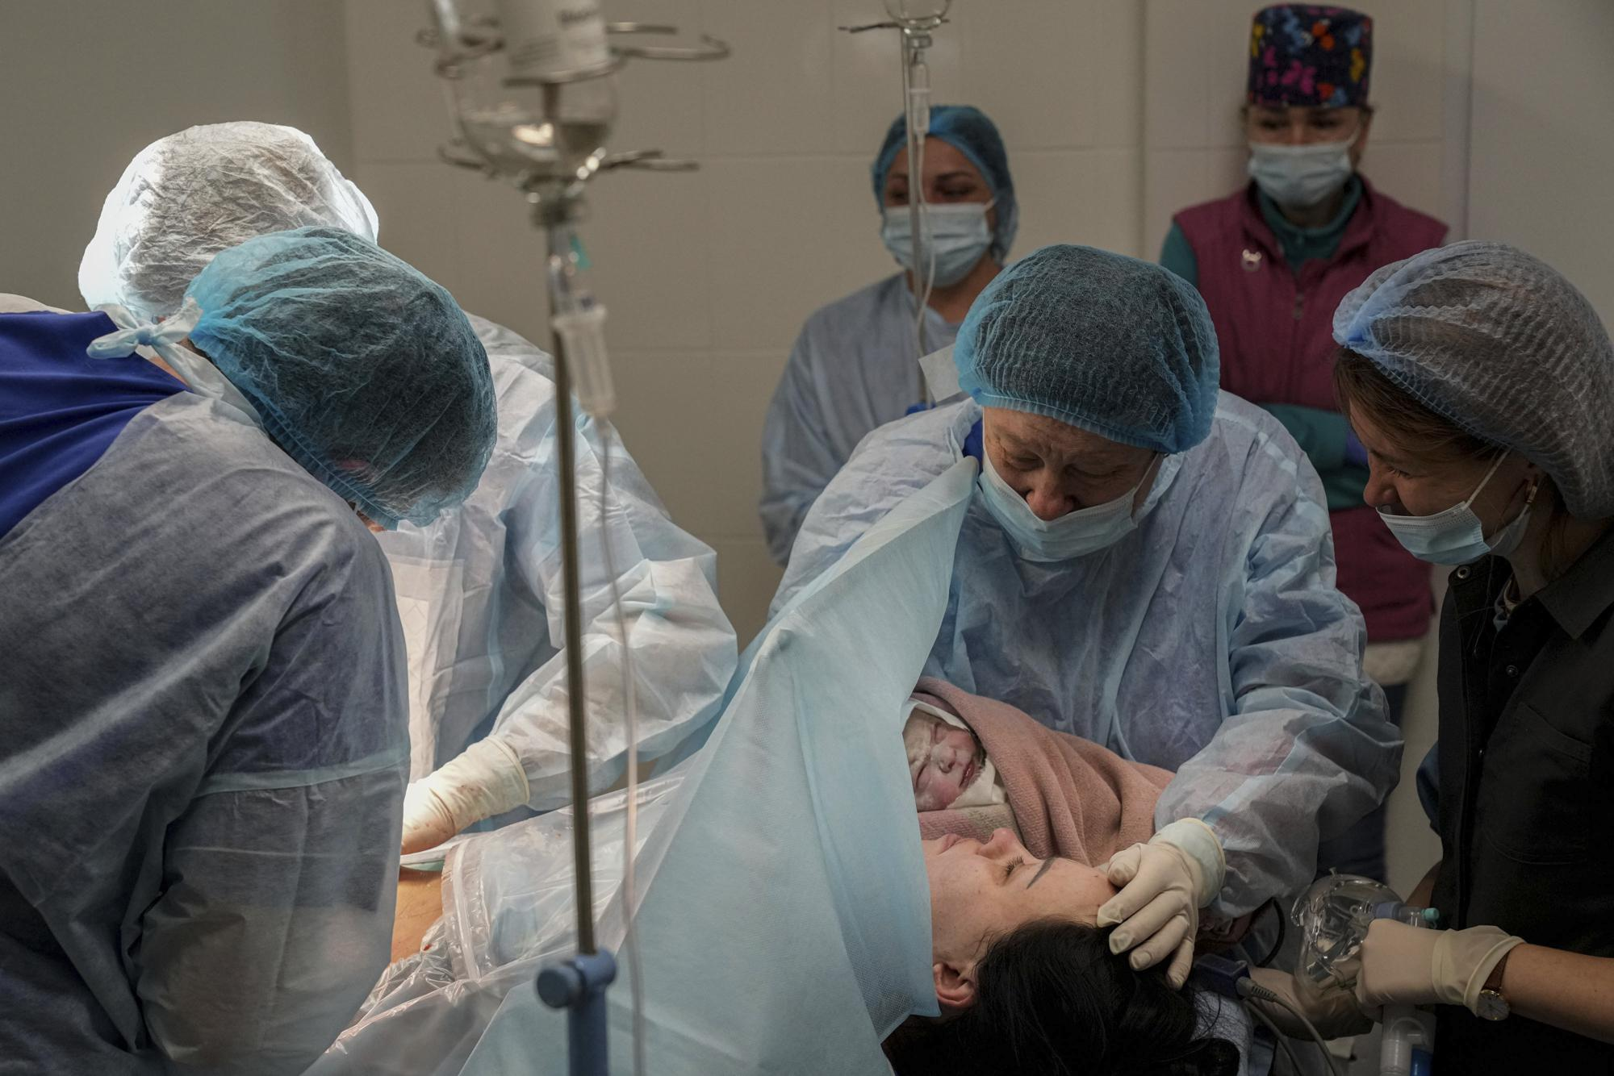
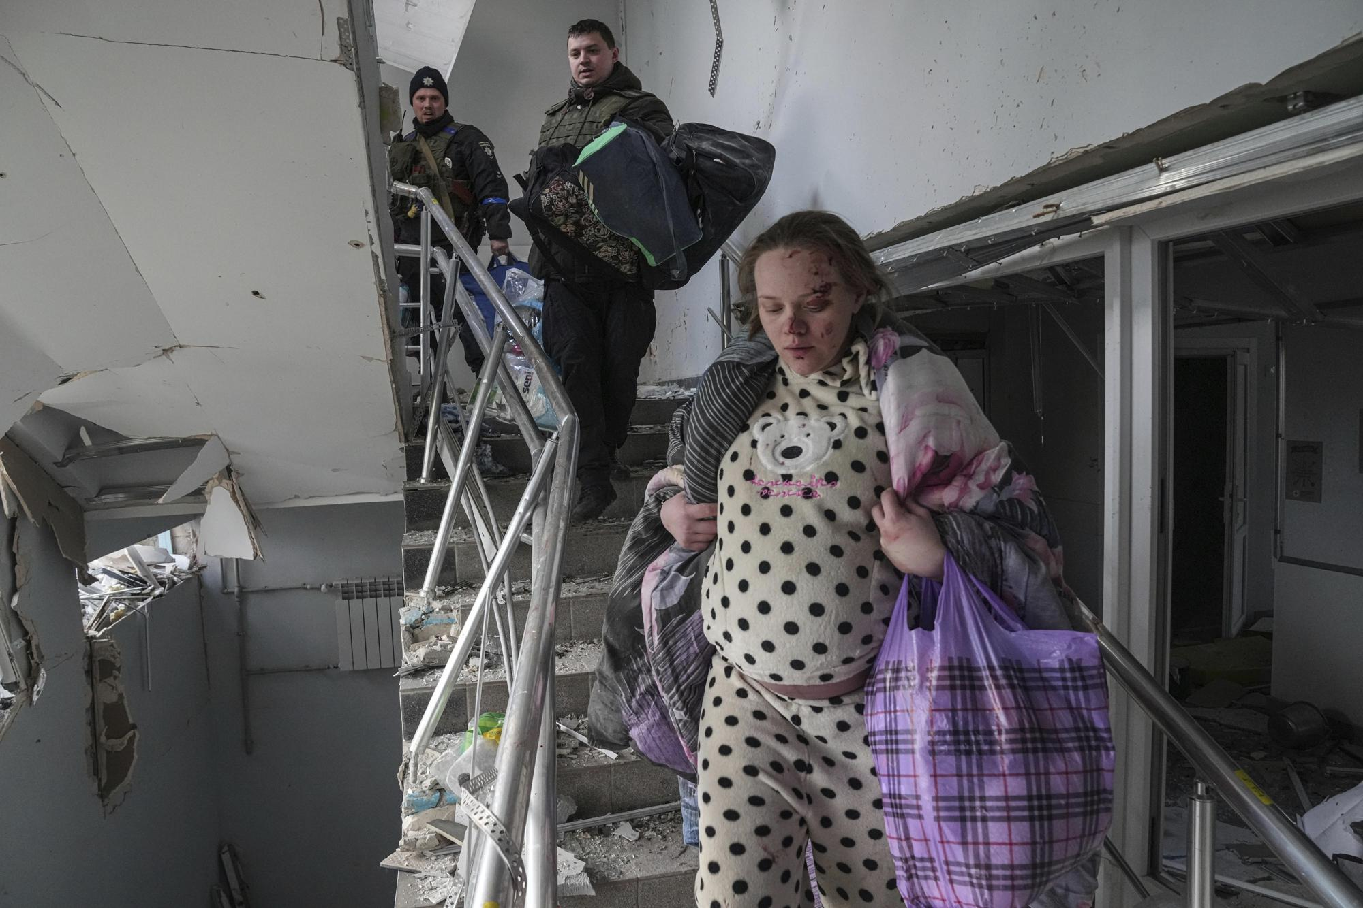
“All birthing mothers have lived through so much,” said nurse Olga Vereshagina AP photos

Slide 29
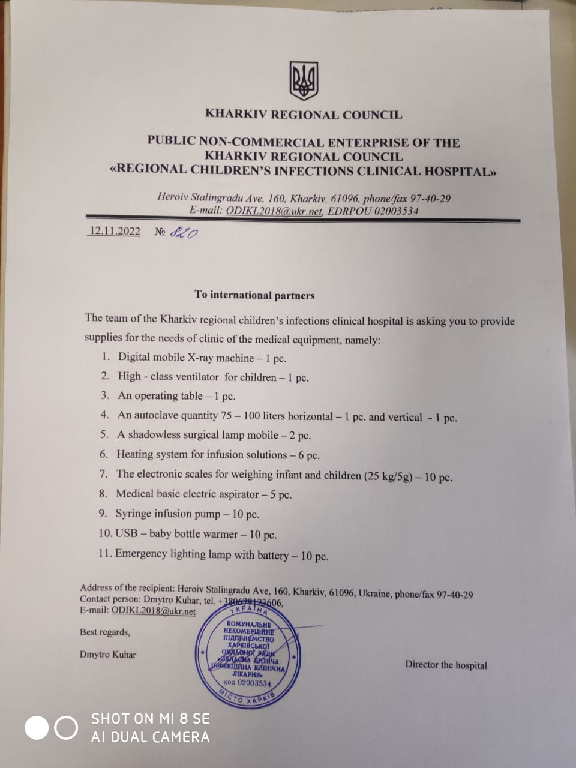
Needs Assessment for Medical Aid for Civilian
Indiscriminate Missile Attacks
Example of Injuries Caused by Missile Attacks on Residential, Hospitals and School Buildings
■ MULTIPLE TRAUMA
■ COMPLEX MEDICAL MULTIPLE INJURIES
■ CRUSH INJURIES TO ALL EXTREMITIES
■ NEUROLOGICAL INJURIES
■ COMPLEX ORTHOPEDIC MULTIPLE FRACTURES AND
TRAUMATIC AMPUTATIONS
■ WOUND CARE MANAGEMENT DRESSING SUPPLIES
■ TRAUMATIC HEAD INJURIES
■ SPINAL CORD INJURIES -BACK INJURIES
■ BIRTH TRAUMA/ EMERGENCY C-SECTION
■ HEMMORAGE CONTROL
■ UPPER AND LOWER EXTREMITY FRACTURES/ AMPUTATIONS
■ CHEST TRAUMA VENTS/CHEST TUBES

Slide 30
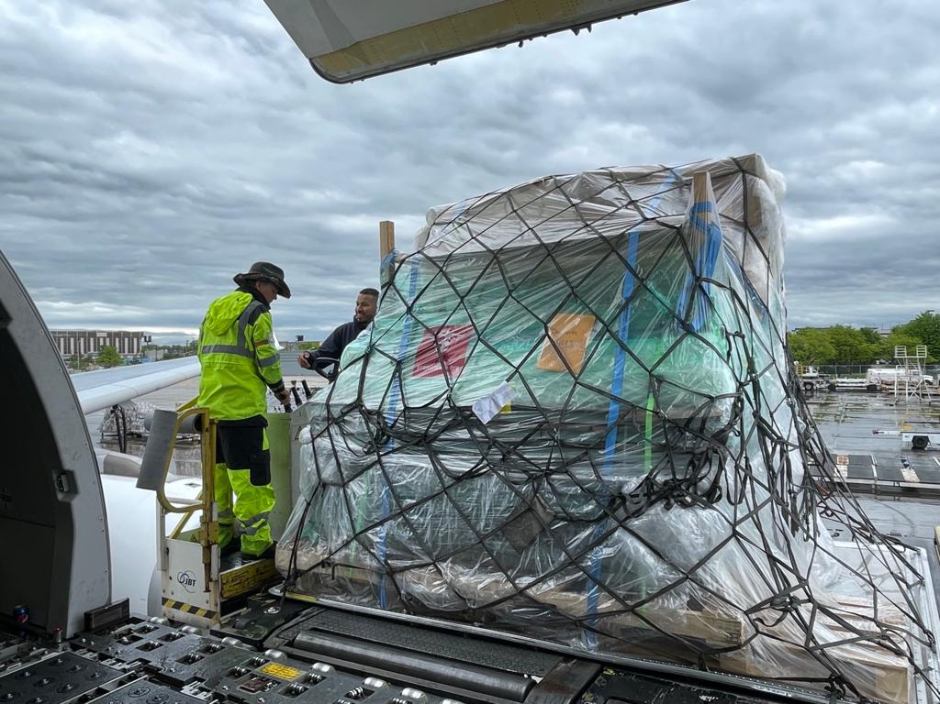
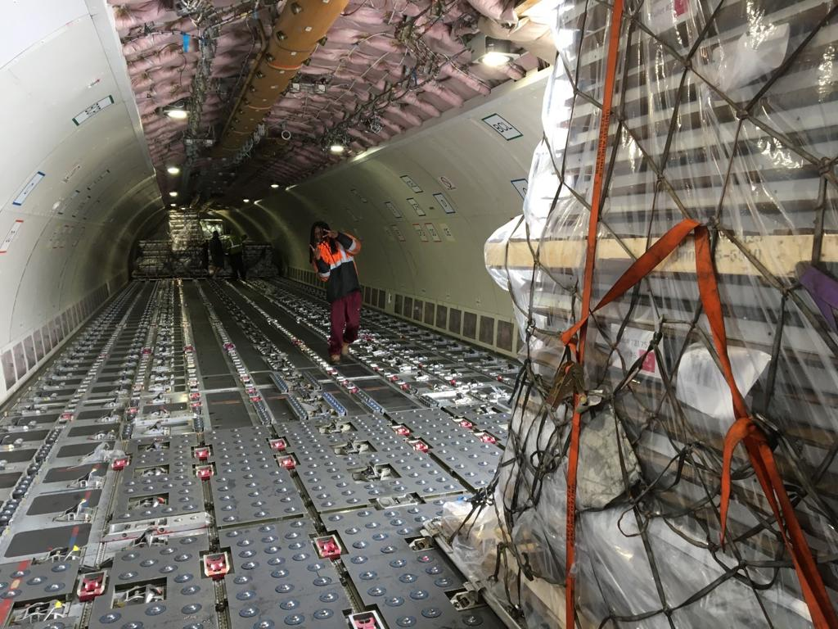
Project C.U.R.E. – Charter Air Cargo flight: Marians had 3 pallets on board!

Slide 31
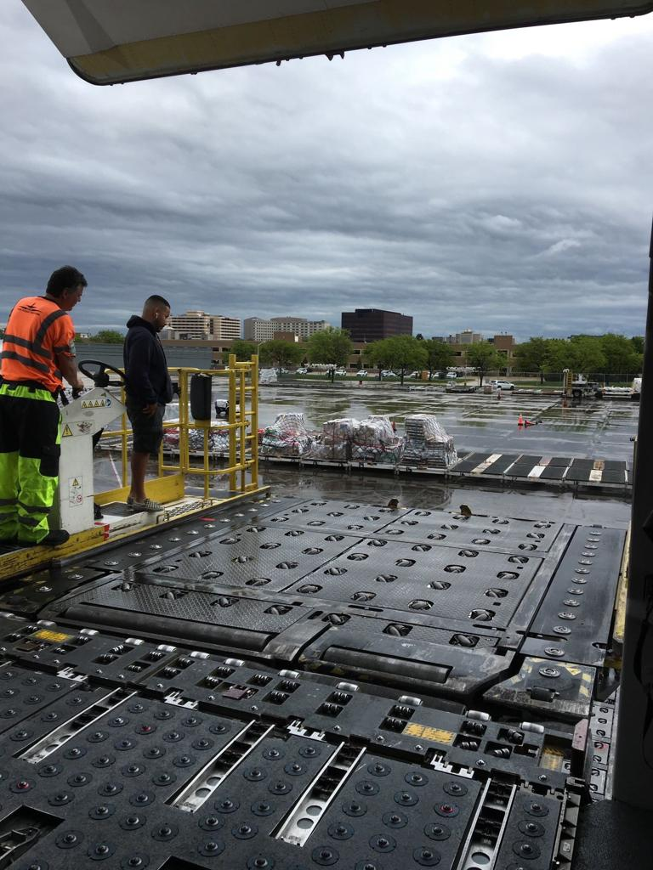
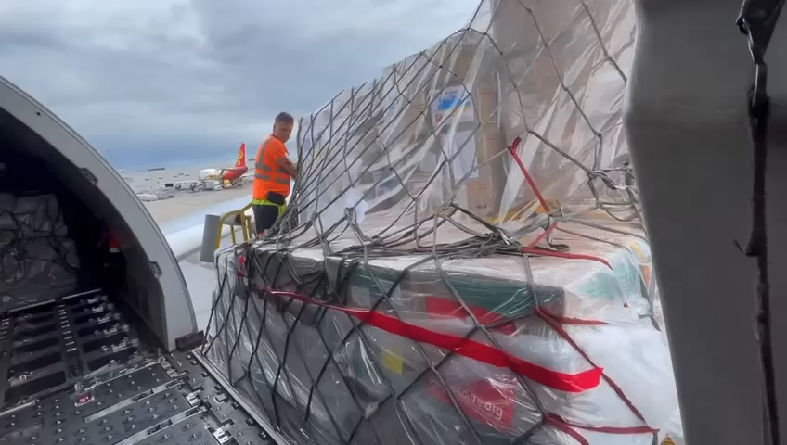
Loading Medical Aid Pallets– Donated Flight

Slide 32
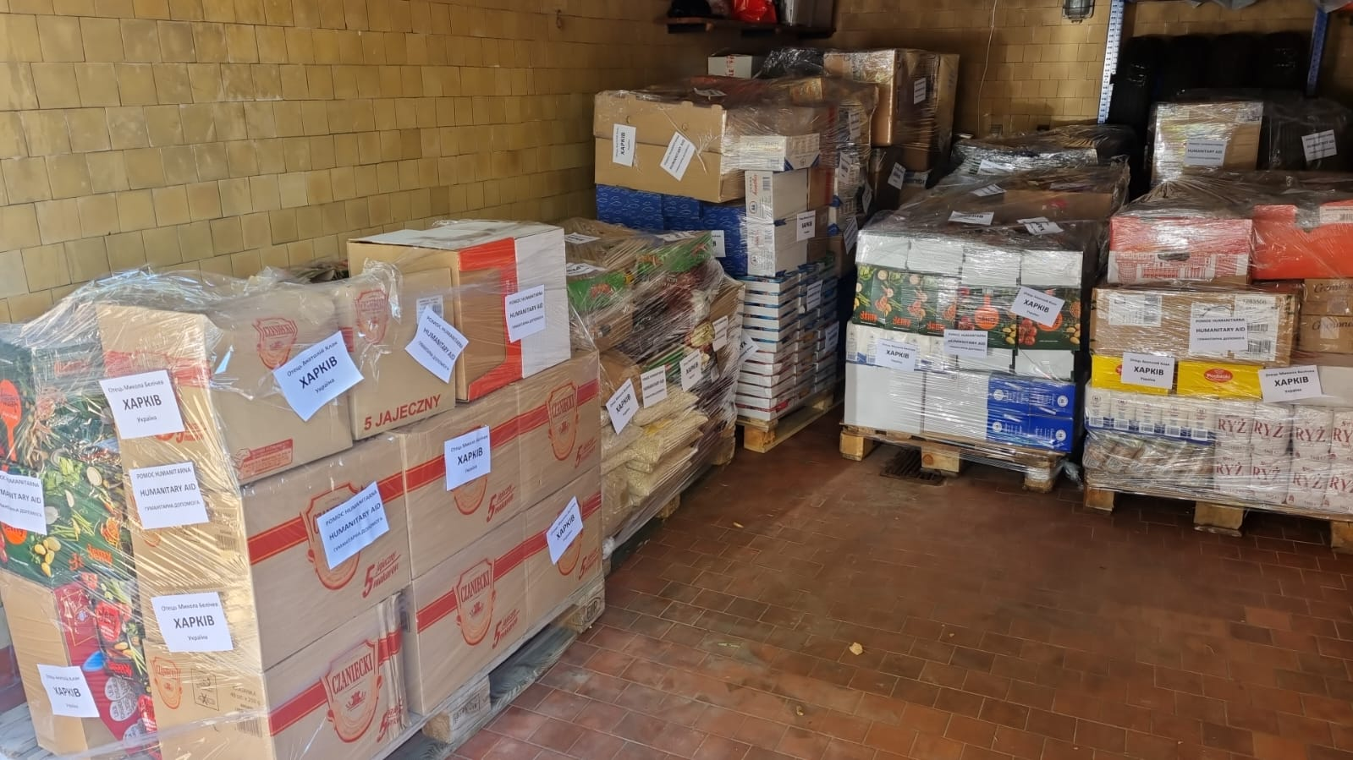
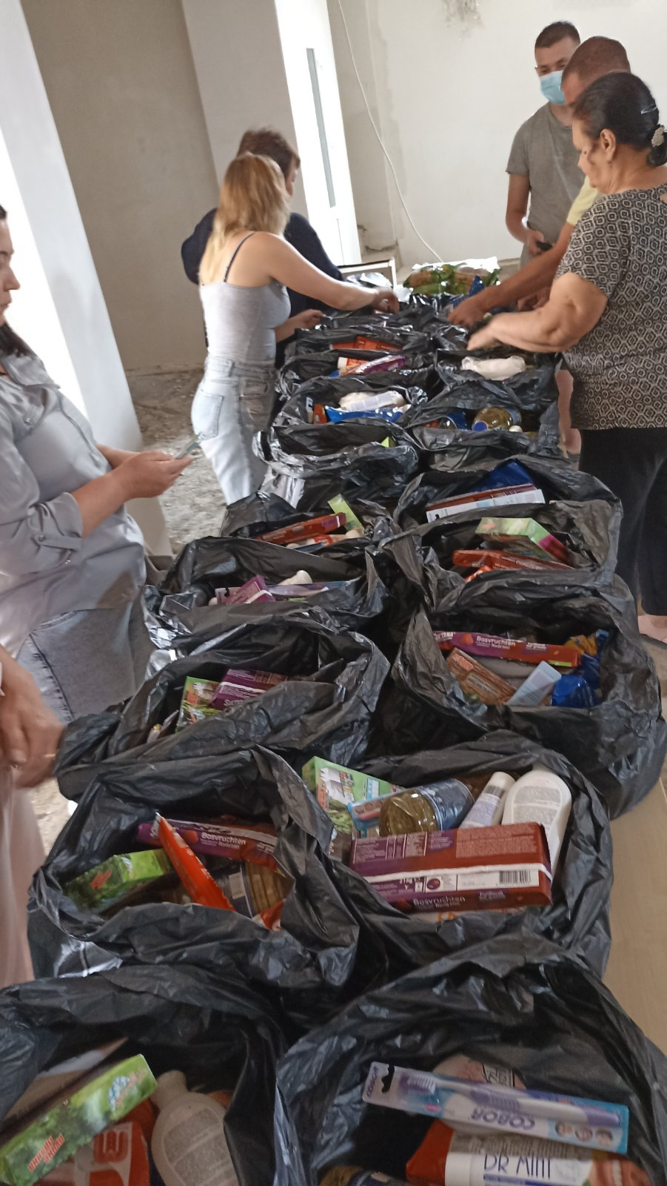
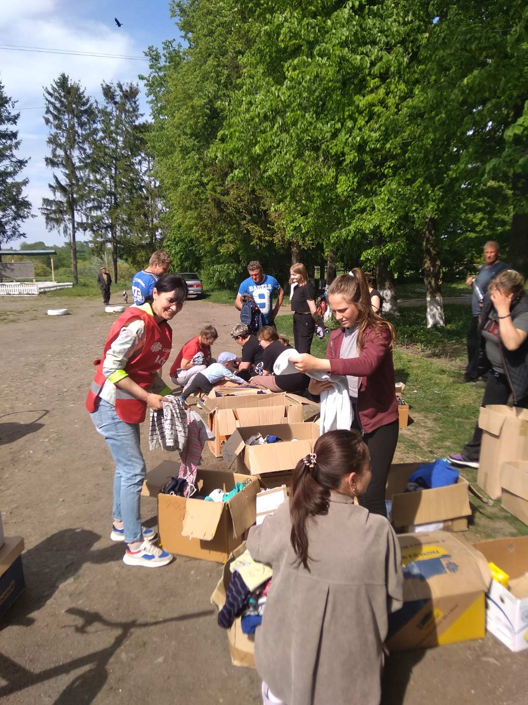
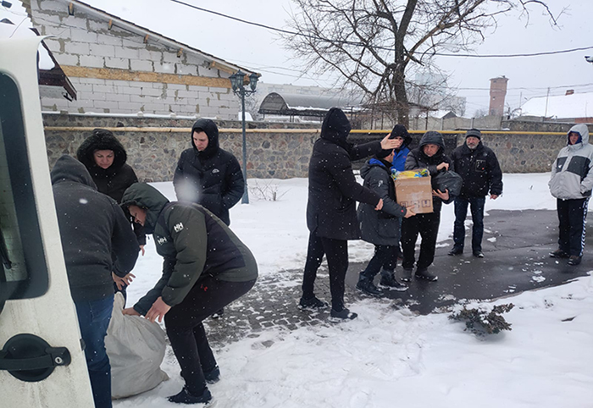
Association of Marian Helpers in Poland Transporting Initial Aid for Ukrainians in need

Slide 33
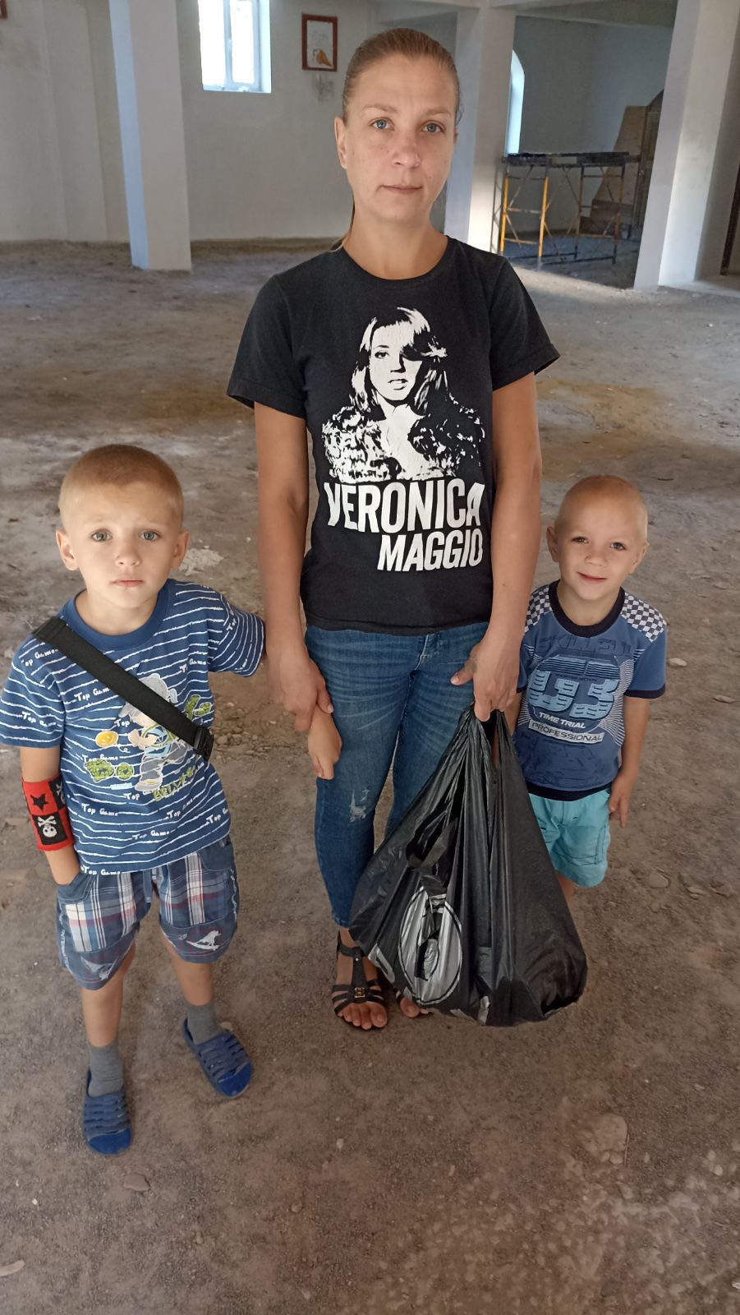
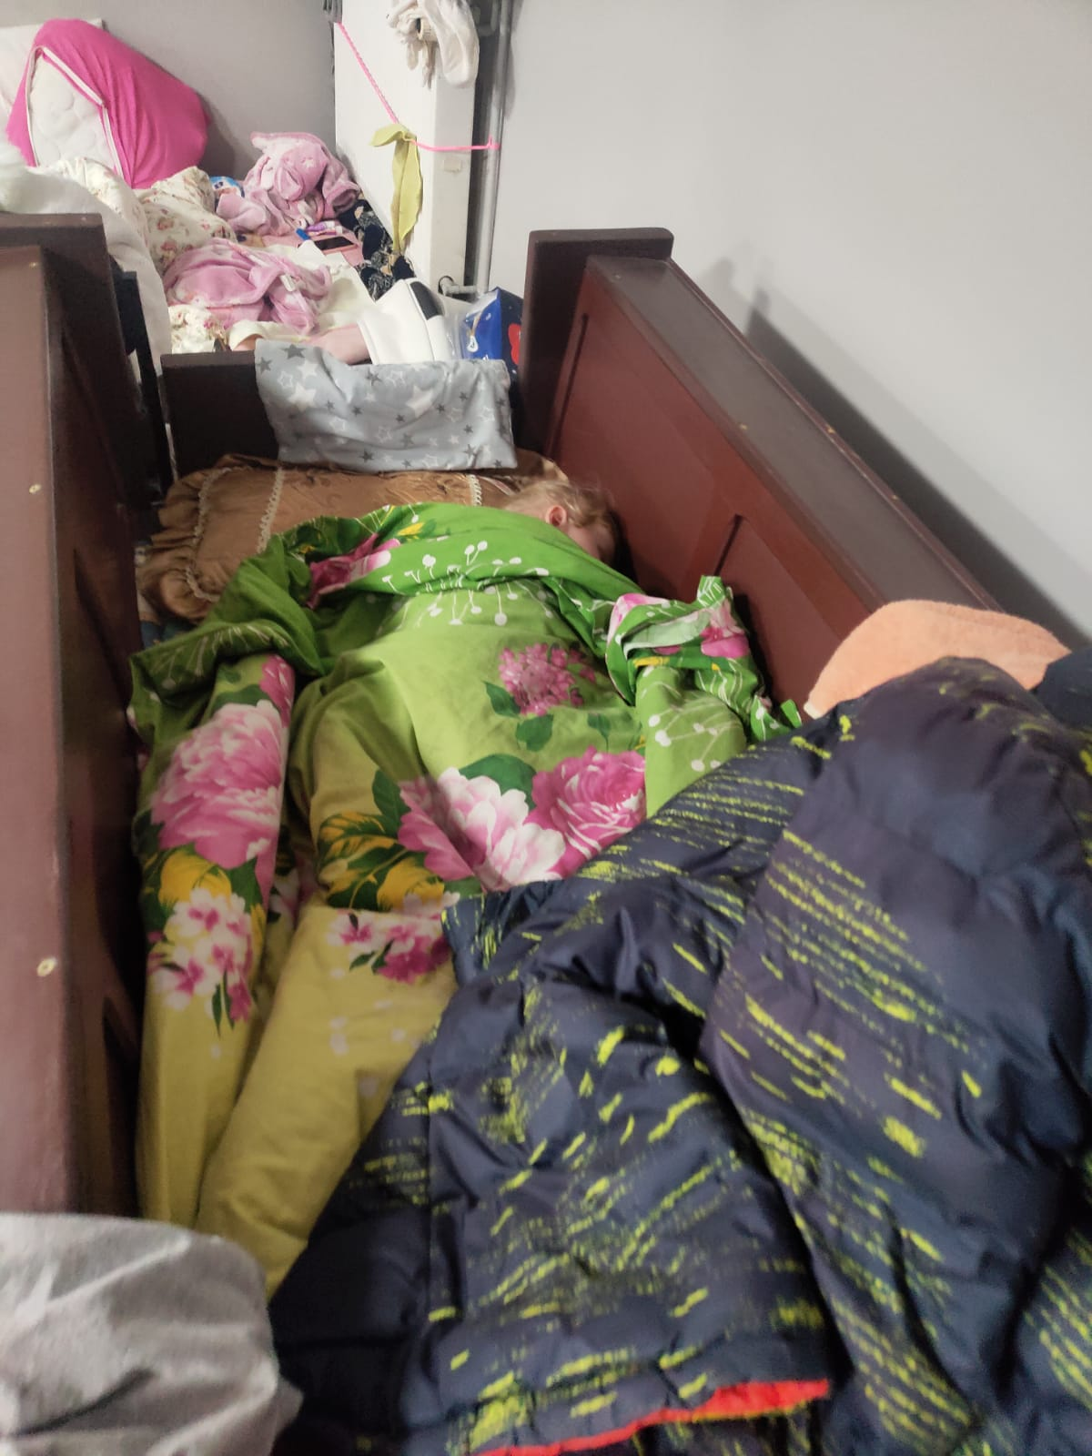
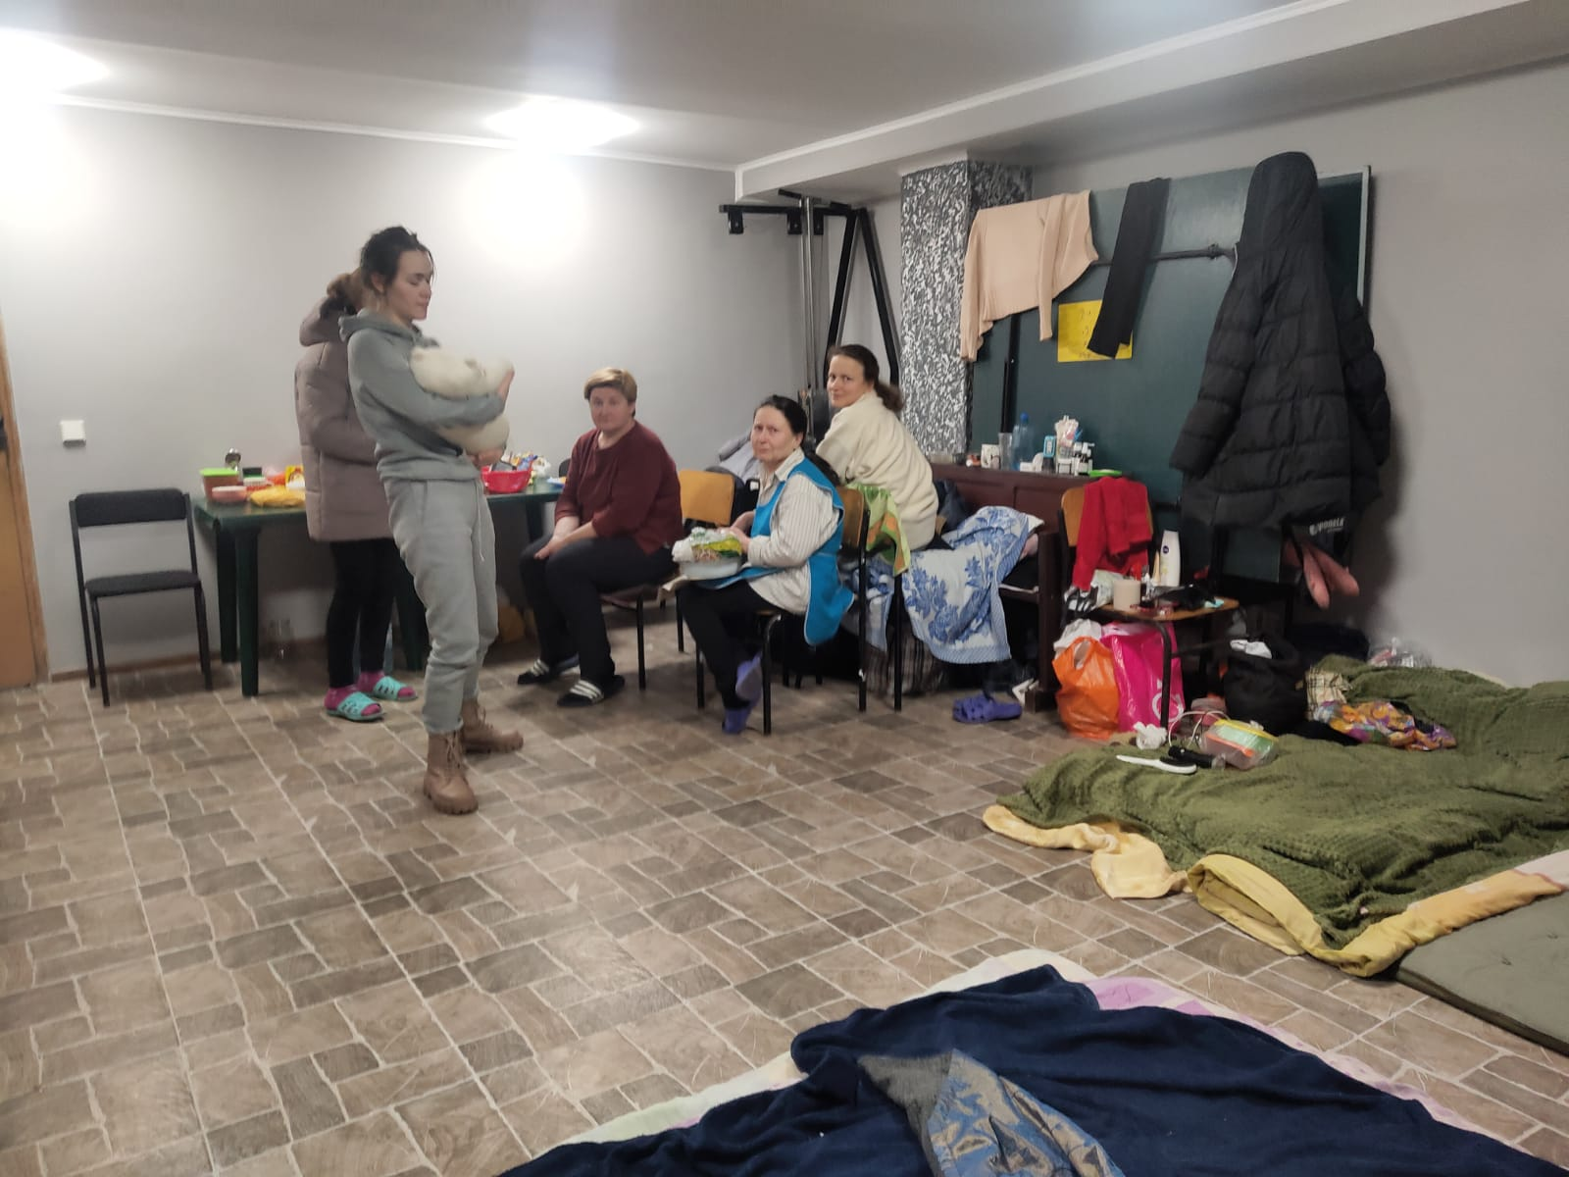
Marians Initially Sheltering Refugees

Slide 34
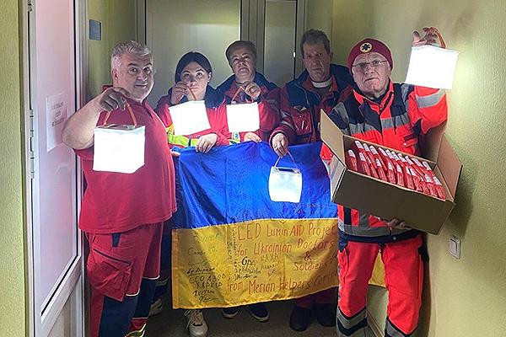
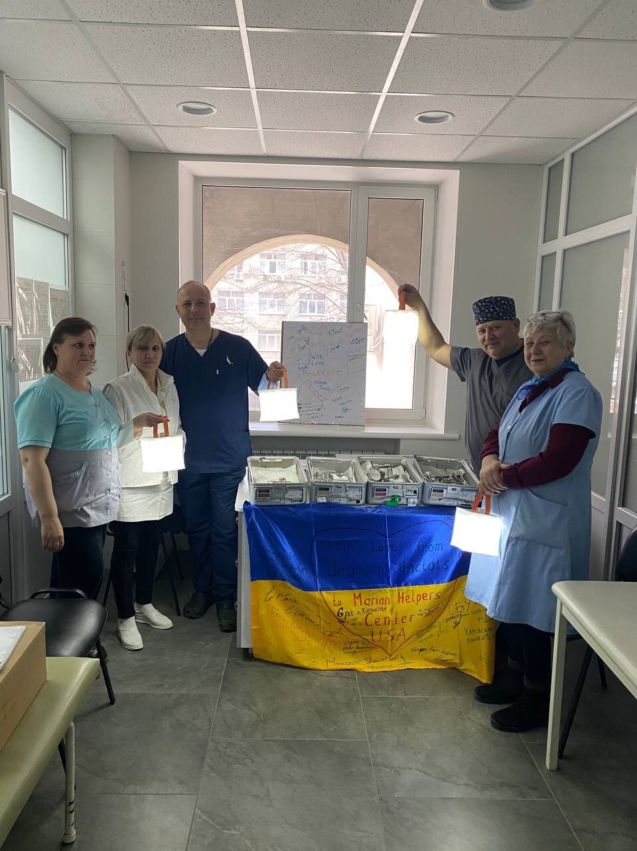
Shipping by Donated Air Cargo
LuminAID Solar Lights

Slide 35
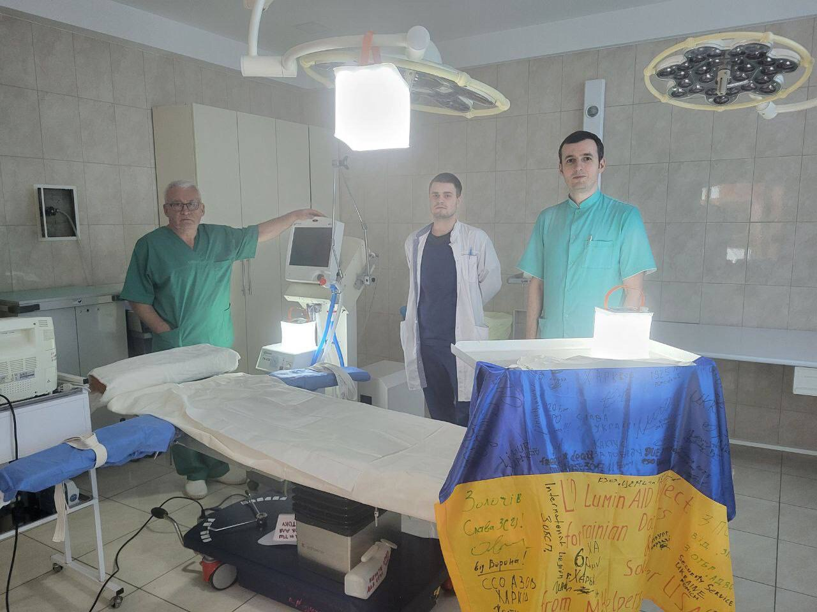
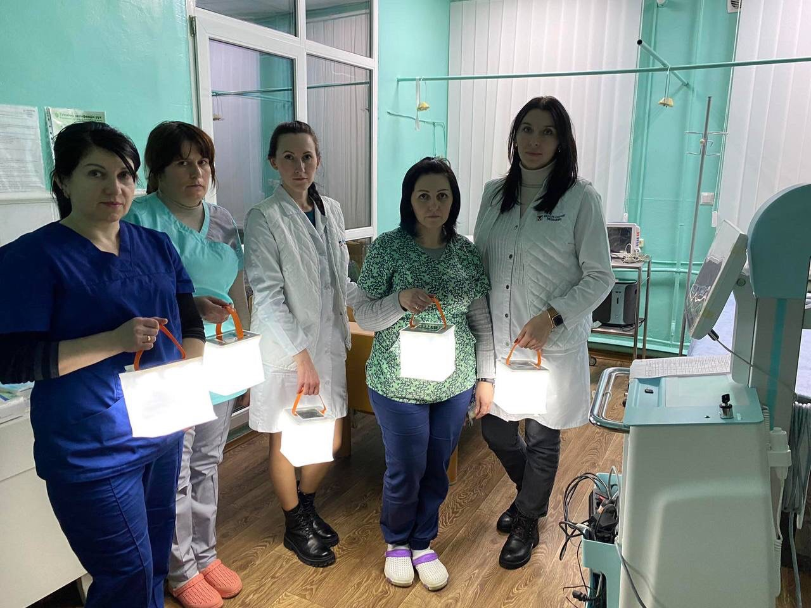
﻿LuminAID Lights for Surgery and Humanitarian Aid

Slide 36
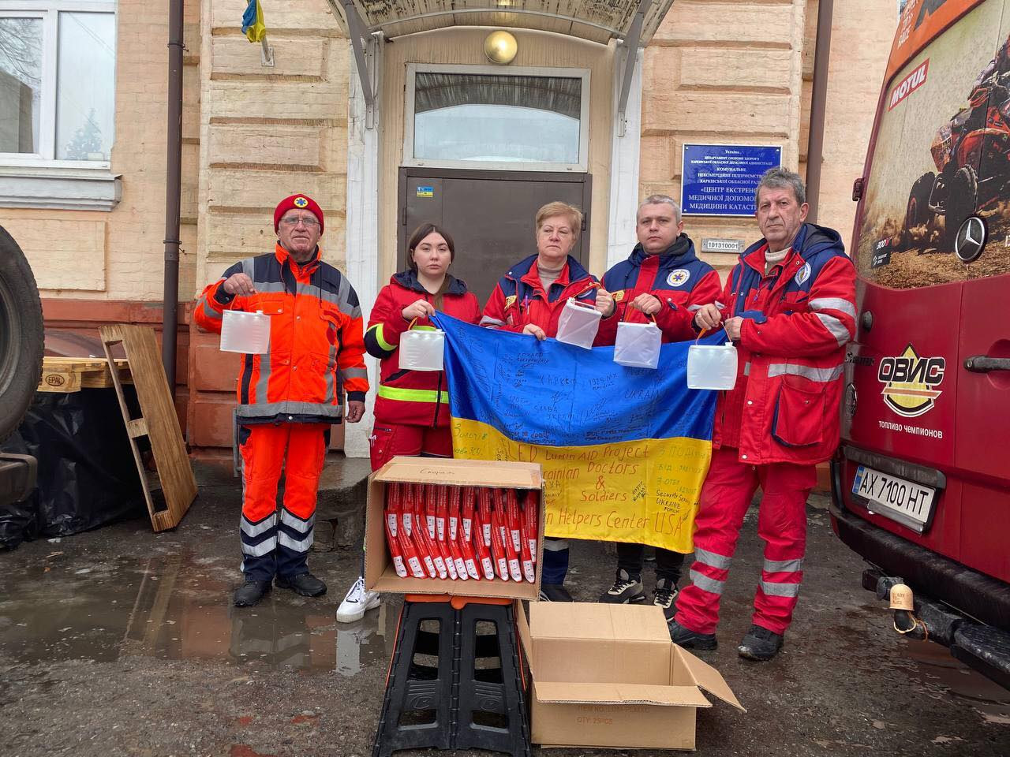

Paramedics at work

Slide 37


﻿Surgical Supplies to hospitals

Slide 38


Specialized Medical Supplies:
Container Delivery was next option

Slide 39


Help pouring in from Marians and Project C.U.R.E.

Slide 40


Surgical Supplies and Receiving Medical Teams

Slide 41


5 Stryker Trauma Kits for Orthopedics and Neurosurgery from Project C.U.R.E. with more Surgical Supplies

Slide 42


Hospital delivery of medical supplies

Slide 43


Neck wound stopped by a Rosary

Slide 44


Power of the Rosary
"Pray the Rosary every day in honor of Our Lady of the Rosary to obtain peace in the world . . . for she alone can save it”
- Our Lady of Fatima, July 13, 1917.

Slide 45



Shipments of Humanitarian Supplies
Marians Provide Play Area for Kids

Slide 46


Marians helping with Project C.U.R.E. for children

Slide 47


Children’s Packs

Slide 48



Container Shipments for Marians with Project C.U.R.E. donated supplies

Slide 49



Marians Mercy House with donated Stryker Emergency beds and food to help the 300 + Refugees

Slide 50


Marians Mercy House Humanitarian Aid

Slide 51



Special Thanks to the Oliver Hoffman Foundation Air Cargo Shipments for the Marians

Slide 52


﻿Marians and Project C.U.R.E. Teamwork

Slide 53
Container Cost and Manifest of Supplies

Slide 54


Custom Packing List
Birthing Kits
Ortho Surgical Packs
Various surgical supplies
Specialized surgical equipment and other surgical supplies
Other medical need supplies
Specialized wound supplies

Slide 55

Marians and Project C.U.R.E. Shipments

Slide 56
How to Join in Helping the Marians
Ukraine Relief Effort
SPONSOR A CONTAINER
DONATE MEDICAL SUPPLIES TO
PROJECT C.U.R.E. for the Marians
A Parish
Individuals
Foundations
Anyone can donate to the Marians for
Ukraine on our website!
Call Dr. Bryan Thatcher 1-877-380-0727
Eucharistic Apostles of The Divine Mercy
Donations: Please visit Marian.org/Ukraine
Accepting non-expired medical supplies and equipment donations at 7 warehouses nationwide.
Call Kristin Robinson at Project C.U.R.E in Kansas City
816-608-1946

Slide 57



Thank You from Ukraine Marians

